Slide 1
COMS10011
Dr. Anne Roudaut
csxar@bristol.ac.uk
https://github.com/coms10011
Probability and Statistics

Slide 2
continuous independent variable
What type of data?
discrete independent variable
continuous dependent variable
discrete dependent variable
Continuous dependent variable
Discrete/categorical dependent variable
regressions
Logistic
regressions
normally distributed
skewed
2 grp
>2 grp
2 grp
>2 grp
2 grp
>2 grp
Non paired
paired
Non paired
paired
Non paired
paired
Non paired
paired
Counts >= 5 in >= 75% cells
Counts >= 5 in < 75% cells
T-test
ANOVA
Paired-t-test
Mann-Whitney Utest
Wilcoxon signed rank test
Kruskall-Wallis test
Chi-square test
Fisher’s exact test
Chi-square test
Friiedman test
McNemar’s test
by the end of this unit you will know what statistics tests to perform depending on your data and how

Slide 3
unit menu
Regression
Hypothesis testing, comparing things
Experimental design
Parametric tests
Normality tests
Non-parametric tests
Categorical data: Chi-square
Sample size, power and effect size
P-hacking

Slide 4
resources

Slide 5
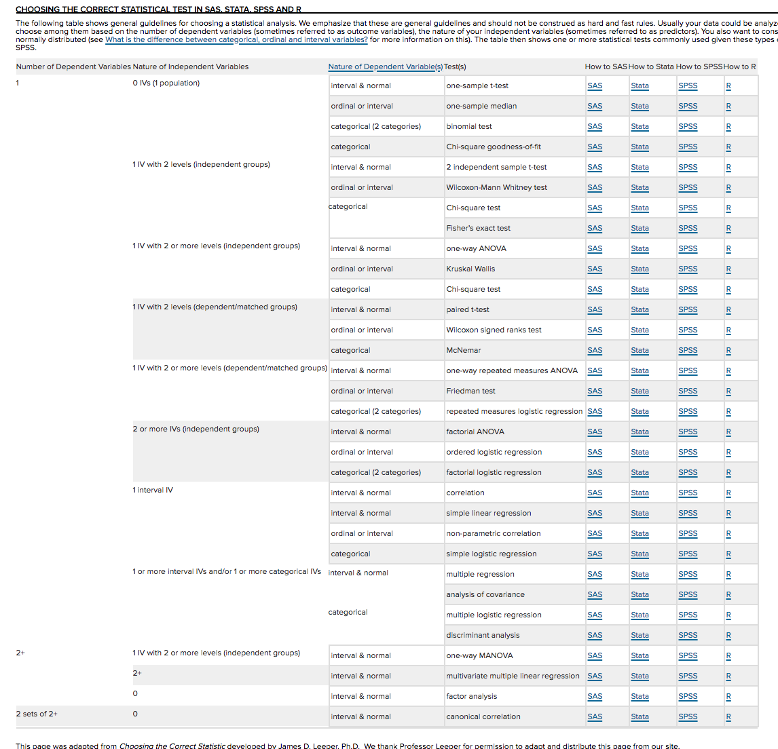
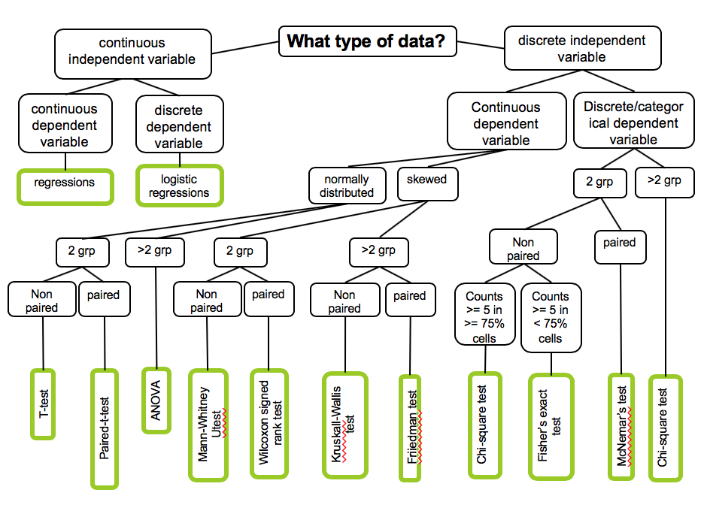
https://stats.idre.ucla.edu/other/mult-pkg/whatstat/

Slide 6
the text book I am using and a suggestion of YouTube video channel

Slide 7
1
regression

Slide 8
continuous independent variable
What type of data?
continuous dependent variable
discrete dependent variable
Logistic
regressions
won’t look
at it
regressions
we are looking at this part of the graph

Slide 9
let’s start with an example

Slide 10
imagine you are designing a graphical interface for a new application on a laptop
how big should the buttons/icons be?

Slide 11
Fitts’law ::
the time required to acquire a target of size w at distance d can be described as T = a + b log (1 + d/w)

Slide 12

smaller bin = harder and further = harder

Slide 13
Fitts’law ::
the time required to acquire a target of size w at distance d can be described as T = a + b log (1 + d/w)
T = a + b IndexDifficulty
(depends on input device)

Slide 14
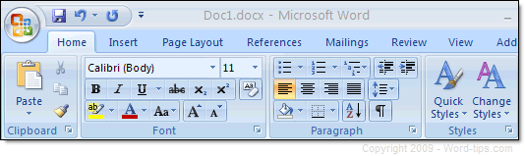
Word 2000
Word today
e.g. one reason why we have ribbons in Word now

Slide 15
Fitts’law :: T = a + b ID
time required to acquire a target
but where does this equation come from?

Slide 16
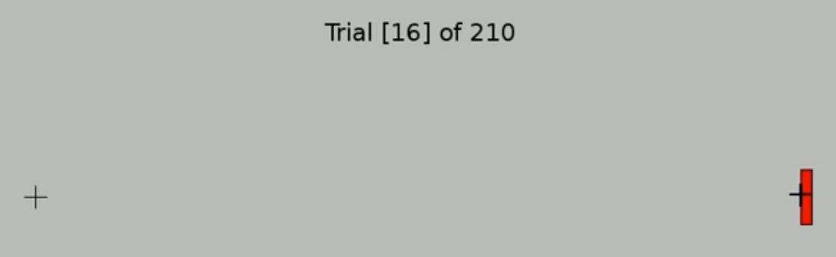
let’s run an experiment and ask one participant to click on targets of different IDs

Slide 17
T time
(ms)
y = a + b x
Fitts! T = a + b ID
ID index of difficulty
this a regression line

Slide 18
regression ::
a technique for determining the statistical relationship between two or more variables where a change in a dependent variable is associated with, and depends on, a change in one or more independent variables
arguably the most basic technique for machine learning

Slide 19
terminology
T time
(ms)
residual (deviation)
b is the slope
ˆ
y = a + b x
a is the y intercept
ID index of difficulty

Slide 20
goodness of fit

Slide 21
T time
(ms)
T = 2.3 + 1.1 ID
ID index of difficulty
how can you be sure this line is a good fit to our data?

Slide 22
T time
(ms)
T = 2.3 + 1.1 ID
ID index of difficulty
how can you be sure this line is a good fit to our data? what about now?
<brainstorming with your neighbor>

Slide 23
we can compute the goodness of fit with several methods
e.g. standard error of the estimate
or R squared

Slide 24
1
standard error of the estimate
T time
(ms)
Fitts! T = 2.3 + 1.1 ID
∑ ( )²
(sample size-2)
ID index of difficulty

Slide 25
1
standard error of the estimate
T time
(ms)
Fitts! T = 2.3 + 1.1 ID
ˆ
∑ (estimated y – actual y)²
(sample size-2)
ID index of difficulty
also called degree of freedom

Slide 26
S gives a standard error in the metric of the data (the less the better)

Slide 27
2
R squared
T time
(ms)
mean
Fitts! T = 2.3 + 1.1 ID
∑ ( )²
ID index of difficulty
∑ ( )²

Slide 28
2
R squared
T time
(ms)
mean
Fitts! T = 2.3 + 1.1 ID
this formula works if your line is computed by the least square regression method (the one used by R)
ˆ
∑ ( estimated y – mean y )²
ID index of difficulty
∑ ( actual y – mean y )²

Slide 29
2
R squared
T time
(ms)
mean
Fitts! T = 2.3 + 1.1 ID
ˆ
you could also find it
in a this format which
is more genetic
∑ (actual y – estimated y )²
1 -
∑ ( actual y – mean y )²

Slide 30
R² gives a percentage and 100% means perfect fit (>70% is better)

Slide 31
T time
(ms)
T = 2.3 + 1.1 ID
R² = 0.97
how can you be sure this is a good fit for all human?
ID index of difficulty

Slide 32
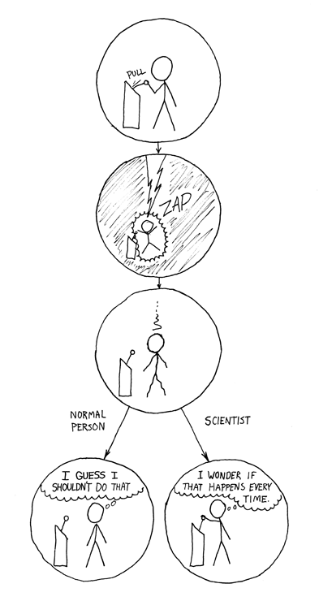
to gain additional confidence we repeat
we gain trust in a model if it fits the data with little error when
it is verified with a lot of data
it holds across very different people
it is verified in independent studies…

Slide 33
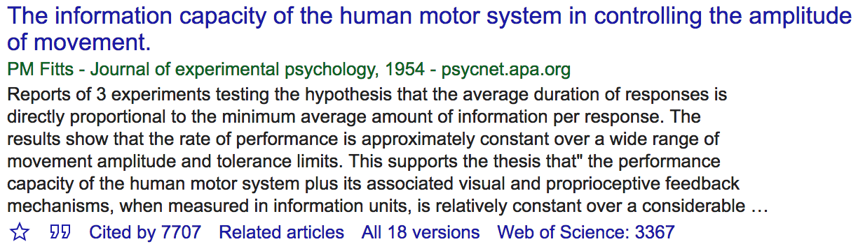
Fitts’s paper probably most cited in HCI, studies done and redone many times
Notes:
28 + brainstorming

Slide 34
practically

Slide 35
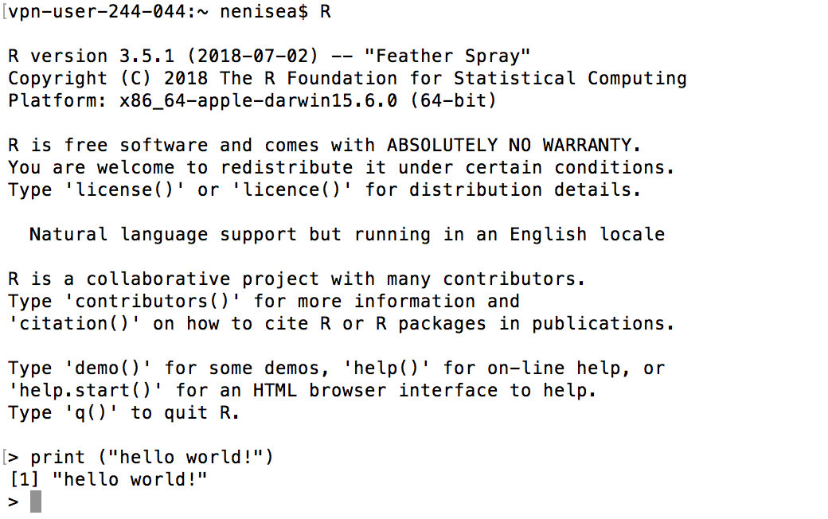
R
Install at
https://www.r-project.org/
we will be using R and I will try to give you as much as possible of examples
Notes:
Open terminal
R
Print(“hello world!”)

Slide 36
R
in your terminal
head(cars) # cars is a table that already comes with R and contain 50 observations of speed and distance in two rows
scatter.smooth(x=cars$speed, y=cars$dist, main="Dist ~ Speed")
linearMod <- lm(dist ~ speed, data=cars) # build linear regression model
abline(linearMod, col="blue") # draw the regression line
summary(linearMod) # goodness of fit
Notes:
head(cars) # cars is a table that already comes with R and contain 50 observations of speed and distance in two rows
scatter.smooth(x=cars$speed, y=cars$dist, main="Dist ~ Speed") # scatterplot
linearMod <- lm(dist ~ speed, data=cars) # build linear regression model on full data
summary(linearMod) # summary(linearMod)$r.squared
abline(linearMod, col="blue")

Slide 37
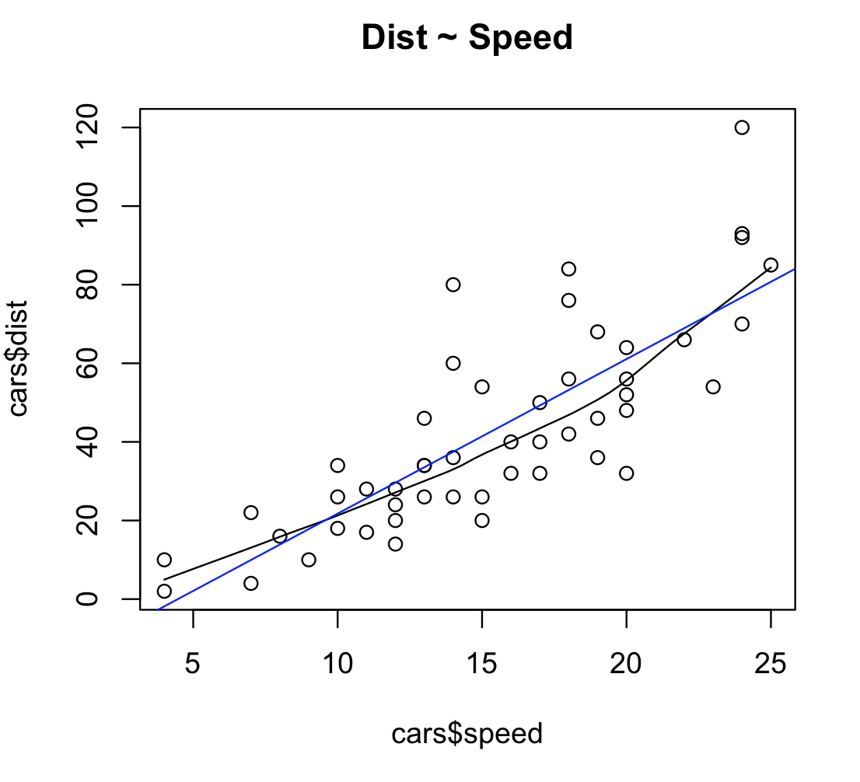
R

Slide 38
R
Call:
lm(formula = dist ~ speed, data = cars)
Residuals:
Min 1Q Median 3Q Max
-29.069 -9.525 -2.272 9.215 43.201
Coefficients:
Estimate Std. Error t value Pr(>|t|)
(Intercept) -17.5791 6.7584 -2.601 0.0123 *
speed 3.9324 0.4155 9.464 1.49e-12 ***
---
Signif. codes: 0 ‘***’ 0.001 ‘**’ 0.01 ‘*’ 0.05 ‘.’ 0.1 ‘ ’ 1
Residual standard error: 15.38 on 48 degrees of freedom
Multiple R-squared: 0.6511, Adjusted R-squared: 0.6438
F-statistic: 89.57 on 1 and 48 DF, p-value: 1.49e-12
dist = -17.5791 + 3.9324 * speed

Slide 39
R
Call:
lm(formula = dist ~ speed, data = cars)
Residuals:
Min 1Q Median 3Q Max
-29.069 -9.525 -2.272 9.215 43.201
Coefficients:
Estimate Std. Error t value Pr(>|t|)
(Intercept) -17.5791 6.7584 -2.601 0.0123 *
speed 3.9324 0.4155 9.464 1.49e-12 ***
---
Signif. codes: 0 ‘***’ 0.001 ‘**’ 0.01 ‘*’ 0.05 ‘.’ 0.1 ‘ ’ 1
Residual standard error: 15.38 on 48 degrees of freedom
Multiple R-squared: 0.6511, Adjusted R-squared: 0.6438
F-statistic: 89.57 on 1 and 48 DF, p-value: 1.49e-12
also note this
pvalue<0.01
pvalue <0
(will explain next week)

Slide 40
usages of regressions

Slide 41

predicting ebay's online auction prices using functional data analysis

Slide 42
predicting the number of passerby who will pass in front of a public display and use the data for choosing advertisement prices

Slide 43
predicting the number of claim in a given time period (used by insurance companies)

Slide 44
understand the impact of a machine (on a production line) on the quality of the products created

Slide 45
understand the relationship between wait times of callers and number of complaints in a call centre

Slide 46
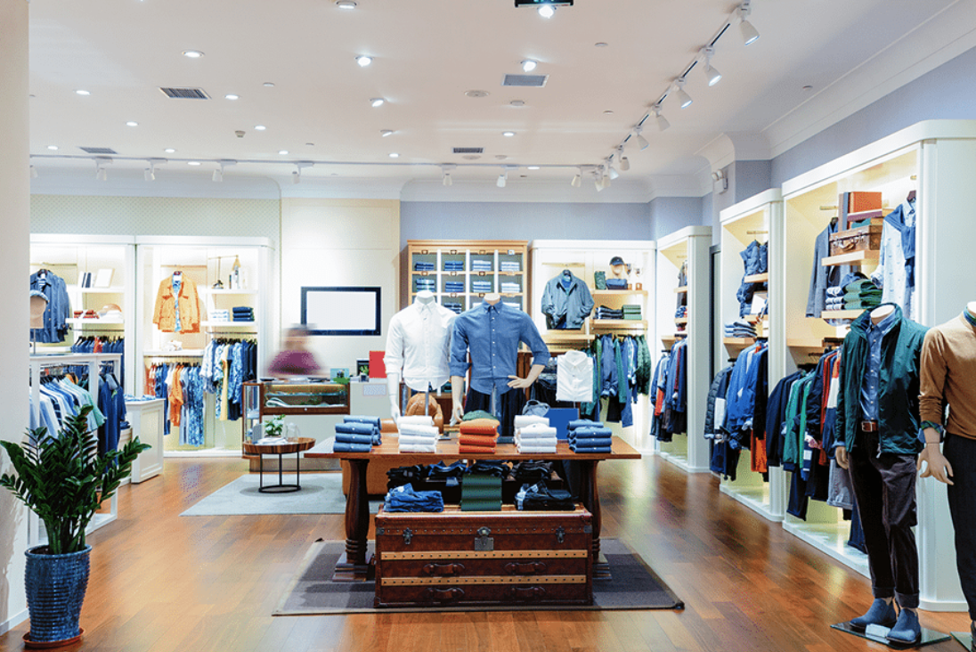
retail store wants to extend shopping hours to increase sales, but regression indicates that increase in revenue not sufficient to support rise in operating expenses

Slide 47
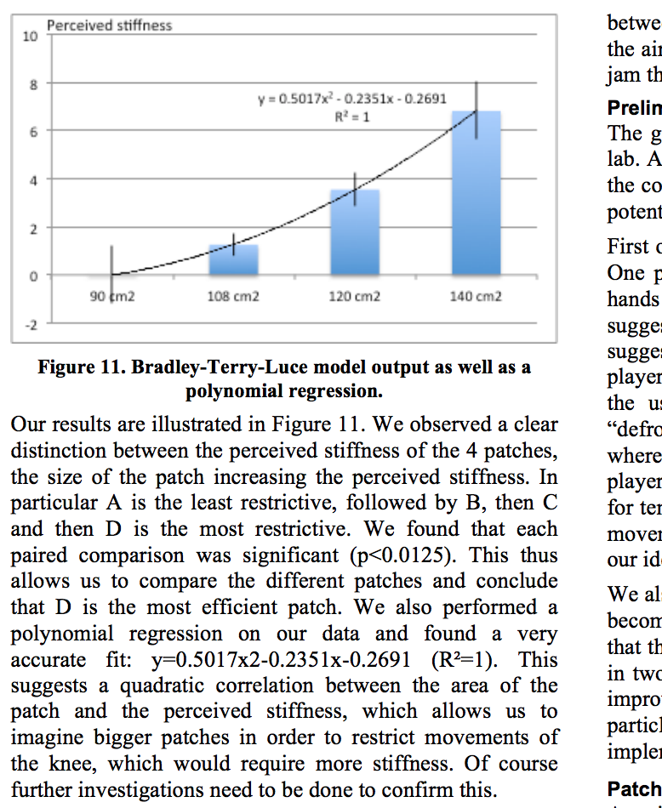
you can also fit a curve =
polynomial fitting

Slide 48
R
polynomial regression model
Mod2 <- lm(dist~poly(speed,2,raw=TRUE), data=cars)
Mod3 <- lm(dist~poly(speed,3,raw=TRUE), data=cars)
Mod4 <- lm(dist~poly(speed,4,raw=TRUE), data=cars)
Notes:
11

Slide 49
take away
Explain what is a linear regression
Give the terminology of a regression line
Give the two formulas of goodness of fit
Be able to compute the two formulas given a few observations

Slide 50
2
hypothesis testing

Slide 51
continuous independent variable
What type of data?
discrete independent variable
continuous dependent variable
discrete dependent variable
Continuous dependent variable
Discrete/categorical dependent variable
regressions
logistic
regressions
normally distributed
skewed
2 grp
>2 grp
2 grp
>2 grp
2 grp
>2 grp
Non paired
paired
Non paired
paired
Non paired
paired
Non paired
paired
Counts >= 5 in >= 75% cells
Counts >= 5 in < 75% cells
T-test
ANOVA
Paired-t-test
Mann-Whitney Utest
Wilcoxon signed rank test
Kruskall-Wallis test
Chi-square test
Fisher’s exact test
Chi-square test
Friiedman test
McNemar’s test
we are looking at this part of the graph

Slide 52
let’s start with a contrived example…

Slide 53
you own a magic pair of shoes. You have run the 10 meters with it a lot and you have a long log of the time you have run with it.
one day, you come home and it seems like someone has moved your shoes. You get concerned that someone might have taken your (beloved) shoes and instead replaced it with identical looking shoes.
you inspect the shoes long and hard and they look the same. But still worried. How do you verify that they are the same?
<30 sec brainstorming>

Slide 54
ok, so you run the 10 meters with the “questionable” shoes a bunch of times.
here is what you see…

Slide 55
2.5-3s 3-3.5s 3.5-4s 4-4.5s 4.5-5s 5-5.5s
2.5-3s 3-3.5s 3.5-4s 4-4.5s 4.5-5s 5-5.5s
your shoes
questionable shoes

Slide 56
[ ] this is still the original shoes
[ ] someone has replaced my shoes
[ ] could be the original or replacement shoes
your shoes
questionable shoes
x
<let’s vote>

Slide 57
the distribution looks different from the shoes you know
while it is possible that it is the same shoes, it seems somewhat unlikely
your die
questionable die

Slide 58
ok, let’s run some more…
2.5-3s 3-3.5s 3.5-4s 4-4.5s 4.5-5s 5-5.5s
2.5-3s 3-3.5s 3.5-4s 4-4.5s 4.5-5s 5-5.5s
your shoes
questionable shoes

Slide 59
[ ] this is probably still the original shoes
[ ] someone probably has replaced my shoes
[ ] could be the original or replacement shoes
your shoes
questionable shoes
x
x
<let’s vote>

Slide 60
again, the distribution could have happened by chance, but it seems even more unlikely. This is probably not your shoes
your shoes
questionable shoes
are you sure this it is not your shoes?

Slide 61
you are not sure.
what can you do to be sure?

Slide 62
there is nothing you can do, you can never be sure
it is a limitation of science:
no matter how often you pull the lever, it could always be chance

Slide 63
the good news:
the more sample (# of runs), the more your confidence increases
→ you can be arbitrarily sure

Slide 64
another round

Slide 65
ok, you get your original shoes back
a week later the same thing happens again. again, you run 10 meters a few times with the questionable shoes …

Slide 66
2.5-3s 3-3.5s 3.5-4s 4-4.5s 4.5-5s 5-5.5s
2.5-3s 3-3.5s 3.5-4s 4-4.5s 4.5-5s 5-5.5s
your shoes
questionable shoes

Slide 67
[ ] this is still the original shoes
[ ] someone has replaced my shoes
[ ] could be the original or replacement shoes
your shoes
questionable shoes
<let’s vote>

Slide 68
[ ] this is still the original shoes
[ ] someone has replaced my shoes
[x] could be the original or replacement shoes
your shoes
questionable shoes

Slide 69
it could be your original shoes, or one that just happens to behave the same. a very, very, good copy maybe.
your shoes
questionable shoes

Slide 70
what are the odds of this being a different shoes?
your shoes
questionable shoes

Slide 71
you cannot compute the odds.
that’s strange! why not?

Slide 72
in both cases, there are two explanations
same shoes
different shoes
your shoes
questionable shoes
this seems unlikely…
…thus this must be true
…now, in the other case

Slide 73
in both cases, there are two explanations
same shoes
different shoes
your shoes
questionable shoes
this does seem not unlikely…
we still have two possible explanations
→ we cannot conclude anything
no thus
…thus…

Slide 74
let’s use stats

Slide 75
statistical significance ::
a result is called statistically significant if it is unlikely to have occurred by chance

Slide 76
before I show you how to compute, let’s test our intuition
I show you pairs of distributions, you tell me if the differences are “statistically different”

Slide 77
2.5-3s 3-3.5s 3.5-4s 4-4.5s 4.5-5s 5-5.5s
2.5-3s 3-3.5s 3.5-4s 4-4.5s 4.5-5s 5-5.5s
could have happened by chance (45% dissimilar)
<30sec brainstorming>
TTEST pvalue = 0.4548

Slide 78
2.5-3s 3-3.5s 3.5-4s 4-4.5s 4.5-5s 5-5.5s
2.5-3s 3-3.5s 3.5-4s 4-4.5s 4.5-5s 5-5.5s
still could have happened by chance (14% dissimilar)
<30sec brainstorming>
TTEST pvalue = 0.1423

Slide 79
2.5-3s 3-3.5s 3.5-4s 4-4.5s 4.5-5s 5-5.5s
2.5-3s 3-3.5s 3.5-4s 4-4.5s 4.5-5s 5-5.5s
unlikely to have happened by chance (0.1% dissimilar)
<30sec brainstorming>
TTEST pvalue = 0.00097

Slide 80
(student’s) t-test
return a p-value
want to verify this: run a t-test

Slide 81
significance level ::
If a test of significance gives a p-value lower than the significance level, such results are informally referred to as 'statistically significant’.
Popular levels of significance are 10% (0.1), 5% (0.05), 1% (0.01), 0.5% (0.005), and 0.1% (0.001).

Slide 82
i.e., oddly, when we want to prove that they are different, we ask whether they are the same…

Slide 83
2.5-3s 3-3.5s 3.5-4s 4-4.5s 4.5-5s 5-5.5s
vs
2.5-3s 3-3.5s 3.5-4s 4-4.5s 4.5-5s 5-5.5s
null hypothesis: both data sets are from same mechanism

Slide 84
we are running stats in the hope that we will be able to reject the null hypothesis

Slide 85
→ if comparison of two groups reveals no statistically significant difference between the two, it does not mean that there is no difference in reality.
It only means that there is not enough evidence to reject the null hypothesis (it fails to reject the null hypothesis).

Slide 86
in both cases, there are two explanations
same shoes
different shoes
your shoes
questionable shoes
this seems unlikely…
…thus this must be true
…now, in the other case

Slide 87
in both cases, there are two explanations
same shoes
different shoes
your shoes
questionable shoes
this does seem not unlikely…
we still have two possible explanations
→ we cannot conclude anything
no thus
…thus…

Slide 88
a classic screw-ups

Slide 89
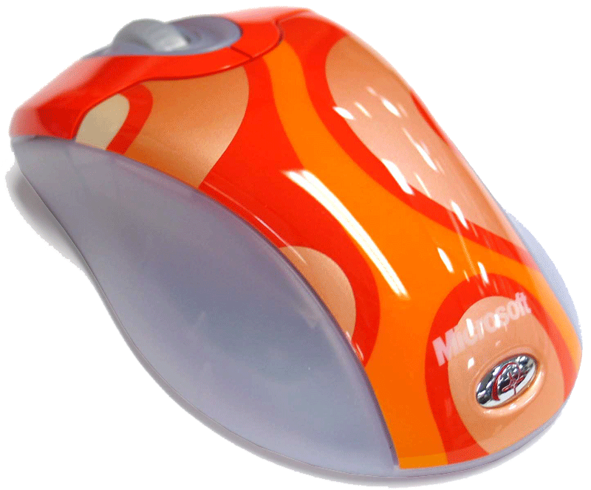
you are making a new input device. You know that it cannot be better than a mouse, but you want to show that it is as good as the mouse.
how do you proceed?
<30sec brainstorming>

Slide 90
how about you run a test and if stats come out non-significant you write “our tests showed that there was no difference”?
nope!
significant difference → mechanisms different
no significant difference →
nothing

Slide 91
so how do you prove that two mechanisms are the same?

Slide 92
in both cases, there are two explanations
same shoes
different shoes
your shoes
questionable shoes
this does seem not unlikely…
no thus
…thus…
you cannot

Slide 93
how to report non-significant results:
“our test did not find a significant difference”

Slide 94
practically

Slide 95
you want to test the effect of two soporific drugs (independent variable) on amount of sleep(dependent variable). You take 10 participants and make then sleep to get their basic (control) sleep time. Then you give them drug 1 and note the difference of sleep time. You do the same for drug 2.
sleep extra drug 1
1 0.7
2 -1.6
3 -0.2
4 -1.2
5 -0.1
6 3.4
7 3.7
8 0.8
9 0.0
10 2.0
sleep extra drug 2
1 1.9
2 0.8
3 1.1
4 0.1
5 -0.1
6 4.4
7 5.5
8 1.6
9 4.6
10 3.4

Slide 96
R
in your terminal
head(sleep) # sleep is the table that already comes with R and contain 20 observations on 10 patients to show the effect of two soporific drugs on the increase in hours of sleep
plot(extra ~ group, data = sleep)
with(sleep, t.test(extra[group == 1], extra[group == 2]))# unpaired
with(sleep, t.test(extra[group == 1], extra[group == 2], paired = TRUE))# paired
you then have two options for t-test: paired or unpaired
Notes:
head(cars) # cars is a table that already comes with R and contain 50 observations of speed and distance in two rows
scatter.smooth(x=cars$speed, y=cars$dist, main="Dist ~ Speed") # scatterplot
linearMod <- lm(dist ~ speed, data=cars) # build linear regression model on full data
summary(linearMod) # summary(linearMod)$r.squared
abline(linearMod, col="blue")

Slide 97
R
you want to test the effect of two soporific drugs (independent variable) on amount of sleep(dependent variable). You take 10 participants and make then sleep to get their basic (control) sleep time. Then you give them drug 1 and note the difference of sleep time. You do the same for drug 2.
all participants did both conditions, i.e. had both drugs
= within subject experiment so the data is paired
otherwise (e.g. take 10 new participants for drug 2)
= between subject experiment so the data is unpaired

Slide 98
R
between subject experiment
with(sleep, t.test(extra[group == 1], extra[group == 2]))# unpaired
data: extra[group == 1] and extra[group == 2]
t = -1.8608, df = 17.776, p-value = 0.07939
alternative hypothesis: true difference in means is not equal to 0
95 percent confidence interval: -3.3654832 0.2054832
sample estimates: mean of x mean of y 0.75 2.33
what you would write
“An unpaired student t-test showed no significant difference between the two drugs.”
Notes:
head(cars) # cars is a table that already comes with R and contain 50 observations of speed and distance in two rows
scatter.smooth(x=cars$speed, y=cars$dist, main="Dist ~ Speed") # scatterplot
linearMod <- lm(dist ~ speed, data=cars) # build linear regression model on full data
summary(linearMod) # summary(linearMod)$r.squared
abline(linearMod, col="blue")

Slide 99
R
within subject experiment
with(sleep, t.test(extra[group == 1], extra[group == 2], paired = TRUE))# paired
data: extra[group == 1] and extra[group == 2]
t = -4.0621, df = 9, p-value = 0.002833
alternative hypothesis: true difference in means is not equal to 0
95 percent confidence interval: -2.4598858 -0.7001142
sample estimates: mean of the differences -1.58
what you would write
“A paired student t-test showed significant difference between the two drugs (two-tailed t(9)=-4.0621, p < 0.05)”
Notes:
head(cars) # cars is a table that already comes with R and contain 50 observations of speed and distance in two rows
scatter.smooth(x=cars$speed, y=cars$dist, main="Dist ~ Speed") # scatterplot
linearMod <- lm(dist ~ speed, data=cars) # build linear regression model on full data
summary(linearMod) # summary(linearMod)$r.squared
abline(linearMod, col="blue")

Slide 100
(note: try to design your studies within-subject as it will increase the chance to reach a smaller p-value
… otherwise need twice more participants!)

Slide 101
R
one vs. two tail?
with(sleep, t.test(extra[group == 1], extra[group == 2], paired = TRUE, alternative=”less")) # or “greater”
Paired t-test
data: extra[group == 1] and extra[group == 2]
t = -4.0621, df = 9, p-value = 0.001416
alternative hypothesis: true difference in means is less than 0
95 percent confidence interval: -Inf -0.8669947
sample estimates: mean of the differences -1.58
what you would write
“A paired student t-test showed significant difference between the two drugs (one-tailed t(9)=-4.0621, p < 0.001).”
Notes:
head(cars) # cars is a table that already comes with R and contain 50 observations of speed and distance in two rows
scatter.smooth(x=cars$speed, y=cars$dist, main="Dist ~ Speed") # scatterplot
linearMod <- lm(dist ~ speed, data=cars) # build linear regression model on full data
summary(linearMod) # summary(linearMod)$r.squared
abline(linearMod, col="blue")

Slide 102
two-tails: effect of drug 1 is > and/or < Drug 2
one-tail: only one side of the effect, i.e.
effect of Drug 1 > Drug 2 (less)
or
effect of Drug 1 < Drug 2 (greater)
e.g. created a shampoo for hair loss and
want to know if better than concurrent one

Slide 103
(note: you will mostly use two-tails but if you can use a one-tail do it, it will increase the chance to reach a smaller p-value!)

Slide 104
multiple
variables

Slide 105
what if we have more than two variables?

Slide 106

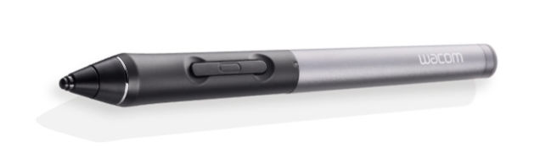
you are making two new input devices, a track pad and a stylus. You want to know which one is better and if they are also better than a mouse.
how do we proceed?
<30sec brainstorming>

Slide 107
a simple solution would be to do this …
ttest1
ttest2
ttest3

Slide 108
a simple solution would be to do this …
problem: any given test has a 5% chance of lying to you so when you use them multiple time you increase your risk of having errors (statisticians call this a “type I error”)
5%
5%
ttest1
ttest2
5%
ttest3

Slide 109
so there are two solutions to that:

Slide 110
bonferroni correction ::
when testing n hypotheses, test each one against 0.05/n

Slide 111
bonferroni correction ::
when testing n hypotheses, test each one against 0.05/n
in our example we would need to use 0.05/3 as a significant threshold instead of 0.05

Slide 112
anova::
analyze of variance to compare multiple variables
one-way anova = one variable with multiple levels
two-way anova = two variables with multiple levels
or you could also use an

Slide 113
… we will look at ANOVA in the next lectures

Slide 114
take away
Explain what is hypothesis testing
Identify the limit of hypothesis testing (we cannot prove that things are similar)
Explain what is a p value and a significance value
Explain what is a t-test and when to use it
Explain the difference between within and between subject studies
Explain what is a Bonferroni correction and find the new significance level given an experimental design

Slide 115
3
experimental design

Slide 116
continuous independent variable
What type of data?
discrete independent variable
continuous dependent variable
discrete dependent variable
Continuous dependent variable
Discrete/categorical dependent variable
regressions
logistic
regressions
normally distributed
skewed
2 grp
>2 grp
2 grp
>2 grp
2 grp
>2 grp
Non paired
paired
Non paired
paired
Non paired
paired
Non paired
paired
Counts >= 5 in >= 75% cells
Counts >= 5 in < 75% cells
T-test
ANOVA
Paired-t-test
Mann-Whitney Utest
Wilcoxon signed rank test
Kruskall-Wallis test
Chi-square test
Fisher’s exact test
Chi-square test
Friiedman test
McNemar’s test
we are still at this part of the graph

Slide 117
let’s do an experiment!

Slide 118
memorization game
group 1
memorize as much
as you can
group 2
if you beat group 1 = chocolate!

Slide 119
take a piece of paper and a pen

Slide 120

I will tell a list of numbers
“1,2,3,6,write”
only when “write” -> write the list on paper
I will show the list
1, 2, 3, 6
if you are correct continue the game
if you wrong stop the game, remember best score

Slide 121
practice trials
1, 4, 9 (size=3)

Slide 122
practice trials
8, 7, 3, 5, 6, 1 ,2 (size=7)

Slide 123
let’s start the real experiment!

Slide 124
trial
3, 2, 8 (size=3)

Slide 125
trial
4, 2, 5, 1 (size=4)

Slide 126
trial
7, 2, 5, 3, 1 (size=5)

Slide 127
trial
6, 2, 9, 8, 5, 1 (size=6)

Slide 128
trial
7, 4, 1, 8, 6, 3, 2 (size=7)

Slide 129
trial
2, 7, 4, 9, 3, 1, 5, 9 (size=8)

Slide 130
trial
1, 6, 7, 8, 5, 3, 1, 4, 6 (size=9)

Slide 131
trial
6, 4, 1, 9, 3, 8, 2, 1, 7, 9 (size=10)

Slide 132
trial
2, 7, 4, 1, 5, 7, 3, 8, 6, 4, 7 (size=11)

Slide 133
what is your best score (size of the list)?
enter it at
https://tinyurl.com/COMS10011

Slide 134
let’s first look at the results

Slide 135
1
5
research question / hypothesis?
look at raw data
2
6
in(dependant) variables?
look at distributions
3a
within or between subjects?
7a
check for normality
3b
counterbalancing?
7b
run some stats
4
8
how many repetitions/trials?
conclude

Slide 136
5
look at raw data

Slide 137
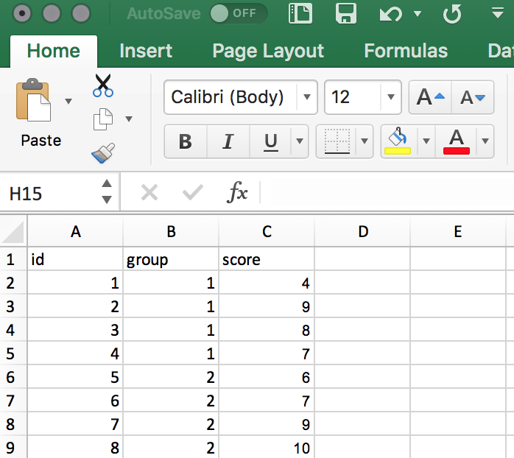
let’s put everything in a table (excel is great for that)

Slide 138
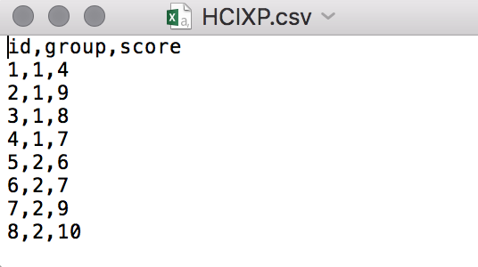
save your file as a .csv (comma separated virgule is a format to store tables as text files)
you can open csv with excel, text file an many other software

Slide 139
R
dat = read.csv("HCIXP.csv", header = TRUE)
print(dat) # look at the file in R
Notes:
head(cars) # cars is a table that already comes with R and contain 50 observations of speed and distance in two rows
scatter.smooth(x=cars$speed, y=cars$dist, main="Dist ~ Speed") # scatterplot
linearMod <- lm(dist ~ speed, data=cars) # build linear regression model on full data
summary(linearMod) # summary(linearMod)$r.squared
abline(linearMod, col="blue")

Slide 140
R
dat = read.csv("HCIXP.csv", header = TRUE)
print(dat) # look at the file in R
library(ggplot2)
ggplot(dat, aes(x = dat$id, y = dat$score)) + geom_bar(stat = 'identity', position = 'dodge')
Notes:
head(cars) # cars is a table that already comes with R and contain 50 observations of speed and distance in two rows
scatter.smooth(x=cars$speed, y=cars$dist, main="Dist ~ Speed") # scatterplot
linearMod <- lm(dist ~ speed, data=cars) # build linear regression model on full data
summary(linearMod) # summary(linearMod)$r.squared
abline(linearMod, col="blue")

Slide 141
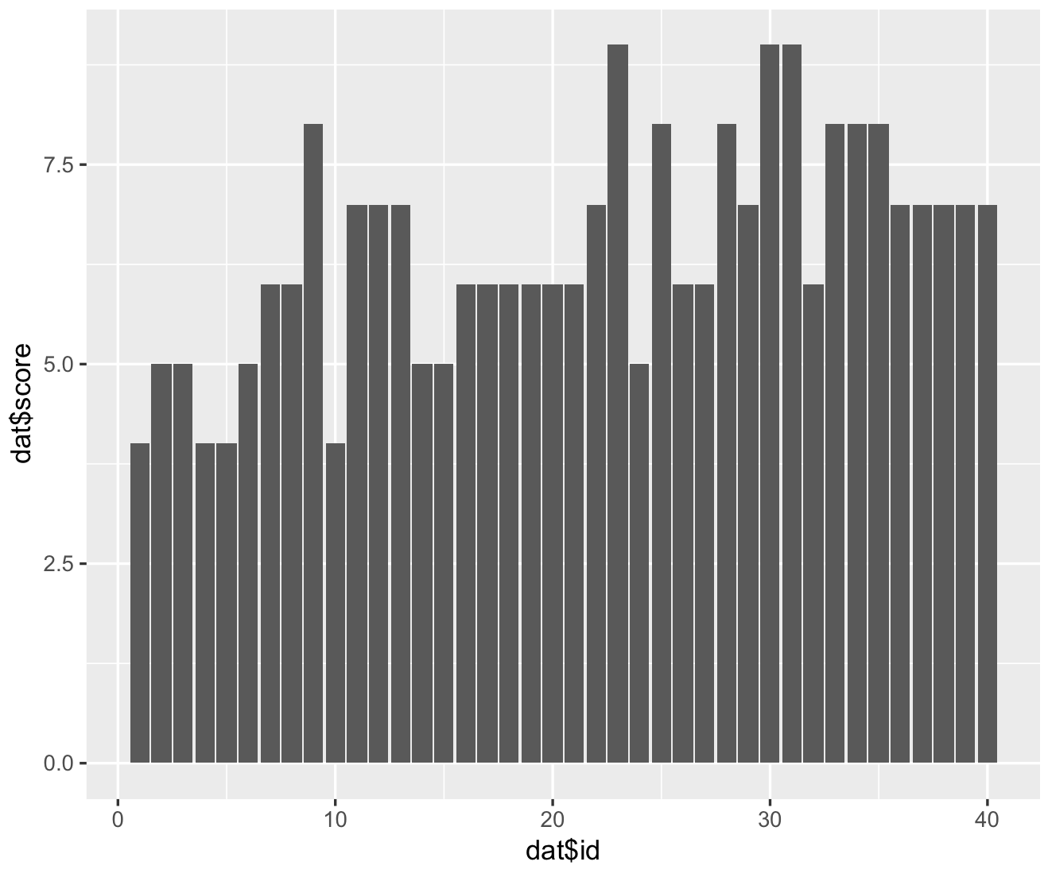
first: does the data look ok?
search for bugs, fatigue effect, learning effect or outliers (>3 times std) = remove / redo xp

Slide 142
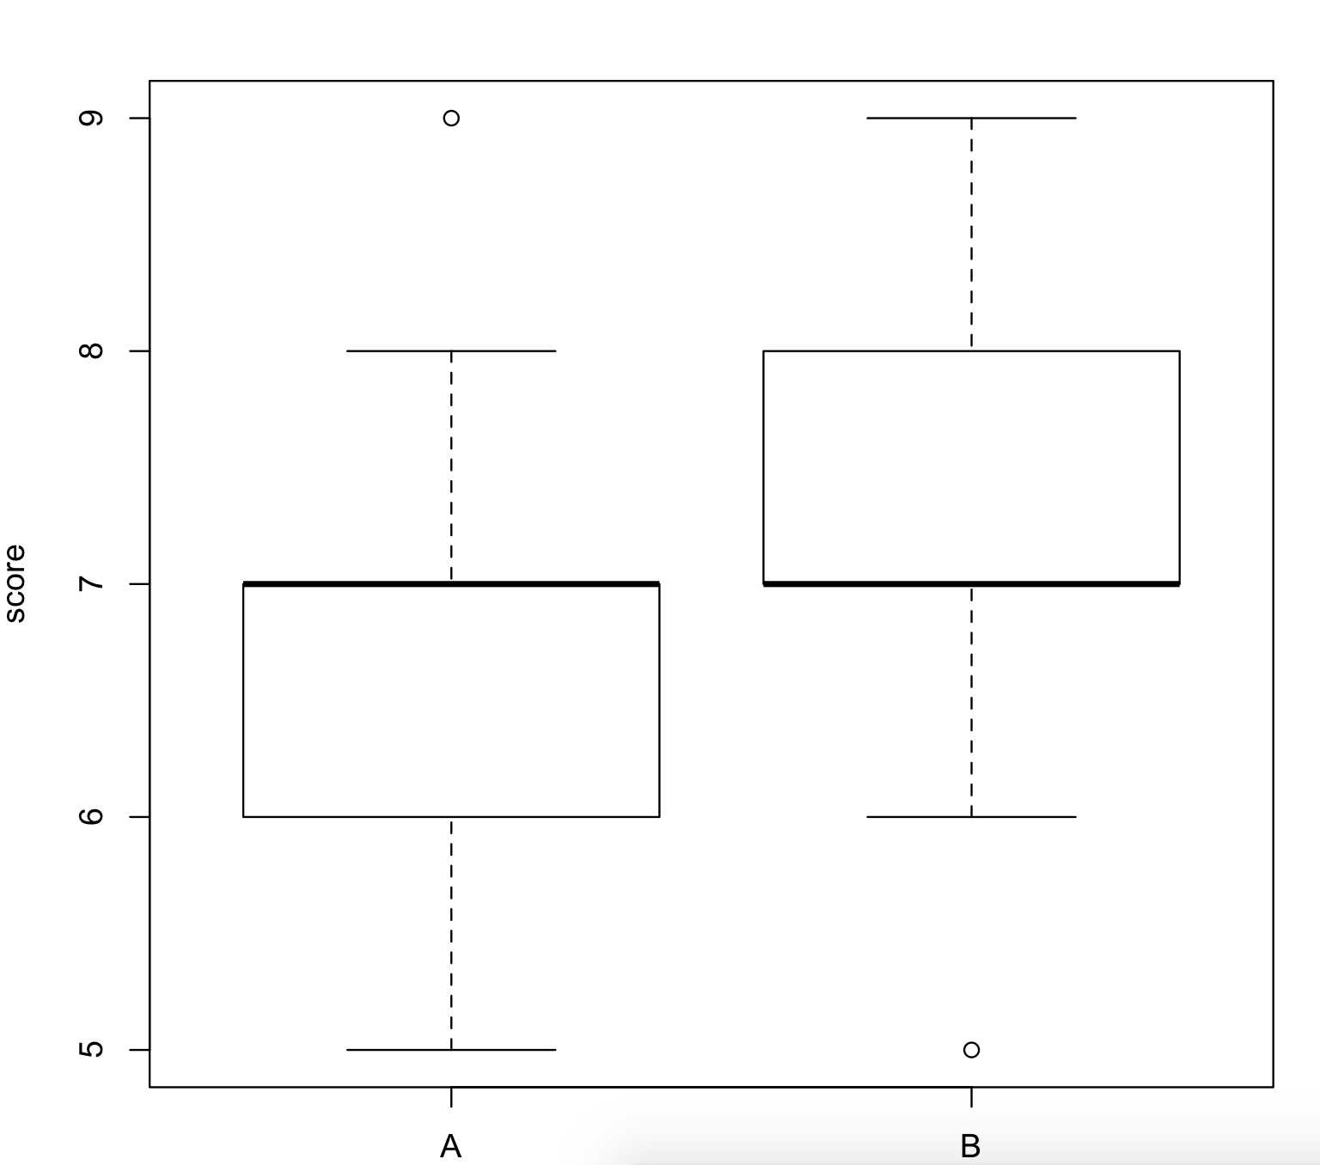
R
plot(score ~ group, data = dat)
Notes:
head(cars) # cars is a table that already comes with R and contain 50 observations of speed and distance in two rows
scatter.smooth(x=cars$speed, y=cars$dist, main="Dist ~ Speed") # scatterplot
linearMod <- lm(dist ~ speed, data=cars) # build linear regression model on full data
summary(linearMod) # summary(linearMod)$r.squared
abline(linearMod, col="blue")

Slide 143
6
look at histograms

Slide 144
R
# Find the mean of each group
library(plyr)
cdat <- ddply(dat, "group", summarise, score.mean=mean(score))
cdat
group score.mean
1 A 5.60
2 B 7.25
# Overlaid histograms with means
ggplot(dat, aes(x=score, fill=group)) + geom_histogram(binwidth=1, alpha=.3, position="identity") + geom_vline(data=cdat, aes(xintercept=score.mean, colour=group), linetype="dashed", size=1) + expand_limits(x = 0, y = 0)
Notes:
head(cars) # cars is a table that already comes with R and contain 50 observations of speed and distance in two rows
scatter.smooth(x=cars$speed, y=cars$dist, main="Dist ~ Speed") # scatterplot
linearMod <- lm(dist ~ speed, data=cars) # build linear regression model on full data
summary(linearMod) # summary(linearMod)$r.squared
abline(linearMod, col="blue")

Slide 145
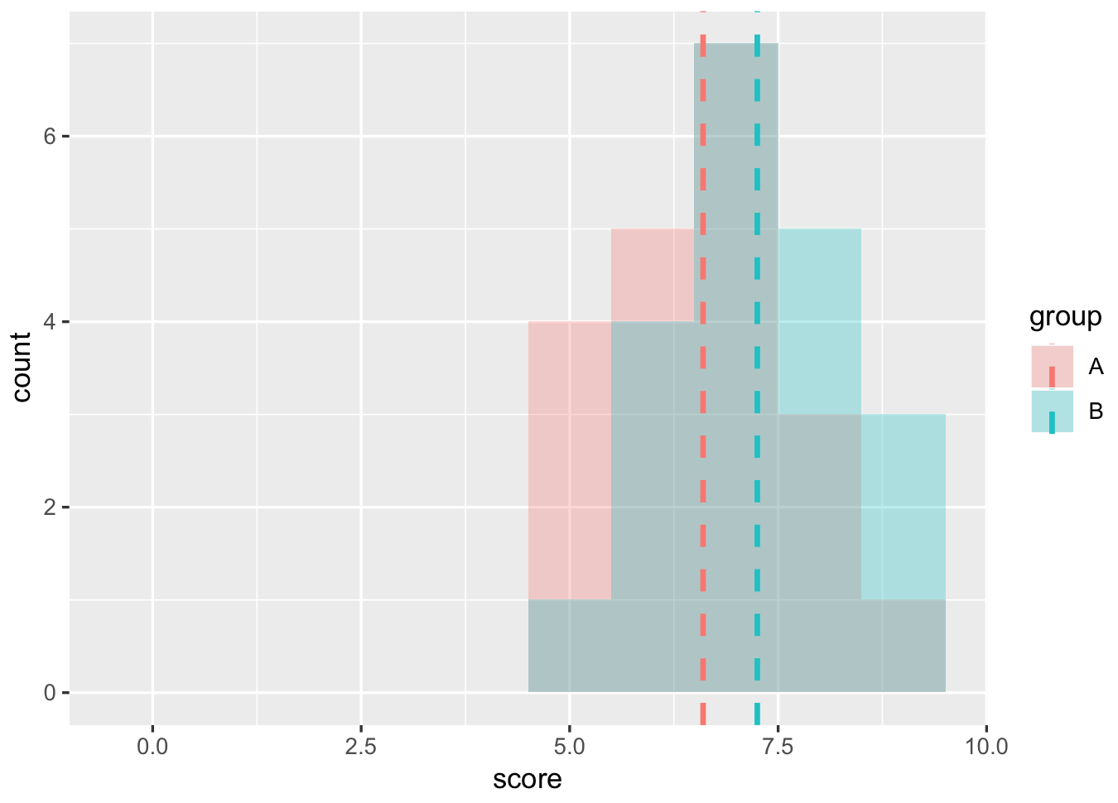
your gut feeling: are these groups different?
are these distributions likely to have happen by chance?
… is this the results of the factor (chocolate)?

Slide 146
7
use a statistic test

Slide 147
R
# Use a t-test (two-tails, unpaired)
t.test(dat$score[dat$group == "A"], dat$score[dat$group =="B"], alternative = "two.sided")
Welch Two Sample t-test
data: dat$score[dat$group == "A"] and dat$score[dat$group == "B"]
t = -1.8185, df = 37.982, p-value = 0.07688
alternative hypothesis: true difference in means is not equal to 0
95 percent confidence interval:-1.37361001 0.07361001
sample estimates: mean of x mean of y 6.60 7.25
“We could not find any significance differences!”
Notes:
head(cars) # cars is a table that already comes with R and contain 50 observations of speed and distance in two rows
scatter.smooth(x=cars$speed, y=cars$dist, main="Dist ~ Speed") # scatterplot
linearMod <- lm(dist ~ speed, data=cars) # build linear regression model on full data
summary(linearMod) # summary(linearMod)$r.squared
abline(linearMod, col="blue")

Slide 148
p-value = 0.07
is is enough to say that the two groups are different?
-> nope, not under significant level of 0.05
can we say that the two groups are same then?
-> nope, can only prove things are different, but not that they are the same

Slide 149
8
conclude

Slide 150
if p was lower than significance level we could say:
“a student t-test showed significant difference between the two group (two-tailed t(46)=4.520, p < 0.005)”
otherwise:
“we did not find any significant results”
cannot conclude, no evidences to show that having chocolate rewards improve memorisation

Slide 151
let’s go backward a little

Slide 152
1
5
research question / hypothesis?
look at raw data
2
6
in(dependant) variables?
look at distributions
3a
within or between subjects?
7a
check for normality
3b
counterbalancing?
7b
run some stats
4
8
how many repetitions/trials?
conclude

Slide 153
1
research question::
a statement that identifies a phenomenon to be studied
in our xp: I believe that rewards improve memorization skills
… suggested by <insert smart guess>

Slide 154
hypotheses::
statement of the predicted relationship between at least two experimental variables
provisional answer to a research question
in our xp: group chocolate will have a higher memorisation score than group with no reward

Slide 155
2
(in)dependent variable ::
the dependent variable is the event studied and expected to change whenever the independent variable is altered

Slide 156
I’M a DR
Independent
Responses
Manipulated
Dependent
Dependent vs Independent variables?

Slide 157
so we want to show that A causes B
vary A → make A an independent variable
measure B → make B a dependent variable

Slide 158
in our xp?
independent variable = group type (nothing vs. chocolate)
dependent variable = memorization score

Slide 159
everything else should be a…

Slide 160
controlled variable ::
the variables that are kept constant to prevent their influence on the effect of the independent variable on the dependent

Slide 161
avoid…
confounding variable ::
extraneous variables that correlates with both the dependent variable and the independent variable

Slide 162
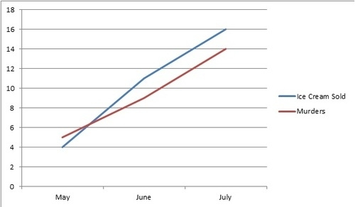
ice cream consumption leads to murder
counfounding : weather temperature

Slide 163
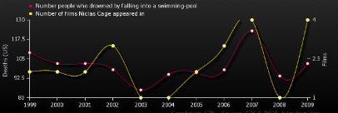
number of people drowned by falling into a swimming-pool correlates with number of films Nicolas Cage appeared in

Slide 164
this is not about correlation
this is about how to show causality, i.e., that some A causes some B

Slide 165
in our xp, do we have confounding variables?
yes, it is not greatly designed :s
gender, age, background, what you ate before, if you like chocolate or not, if you are competitive and want the others not to have chocolate, if some of the numbers are familiar to you etc.
what can we do about it?
avoid them by controlling as much as you can in the environment
if you cannot, make it an independent variable (e.g. gender)
some are inherent noise (human individuality), use more participants to get statistical power

Slide 166
the goal of a quantitative study is to find a signal in a lot of noise

Slide 167
experimental design:
aims at maximizing your chances of finding the signal and not the noise

Slide 168
need to absolutely avoid systematic biases
(e.g., learning effect, fatigue). They give you false results!
2. avoid random noise. It makes your results non-significant. Clever experimental design is all about keeping the noise down

Slide 169
e.g. in our xp, I made you practice before!

Slide 170
3
a
within vs. between?
within = all participants do same
between = participants do only certain conditions

Slide 171
3
a
within vs. between?
within = all participants do same
between = participants do only certain conditions
suffer less user variation
statistical power with less participants
no biases from other conditions (e.g. transfer of learning)

Slide 172
in our xp, it had to be between subjects
(because of the rewards)
participants did not do all conditions:
½ did the control condition
½ the reward condition

Slide 174
imagine a within subjects (test how fast we click an icon):
participants do all conditions:
they start with the trackpad
when finished they do the mouse
is it a good idea?
nope -> learning effect

Slide 175
3
b
counterbalancing ::
a method of avoiding confounding among variables
presenting conditions in a different order

Slide 176
one approach to counterbalancing is to use a…

Slide 177

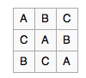
Latin square ::
an n × n array filled with n different Latin letters, each occurring exactly once in each row and exactly once in each column.

Slide 179
4
how many trials?
ideally make as much trials as you can to reduce noise but try to keep experiment around 30 min … max 40 min

Slide 180
in our xp, we did only one trial because of time constraint, but should have done more to reduce noises

Slide 181
1
5
research question / hypothesis?
look at raw data
2
6
in(dependant) variables?
look at distributions
3a
within or between subjects?
7a
we will see why
check for normality
3b
counterbalancing?
7b
run some stats
so far we know t-test
4
8
how many repetitions/trials?
conclude

Slide 182
let’s complexify a little

Slide 183
in our xp, let’s add a 3rd imaginary group
they get a slap if they had the smallest memorisation score
(obviously not ethical so let’s keep this hypothetical!)

Slide 184
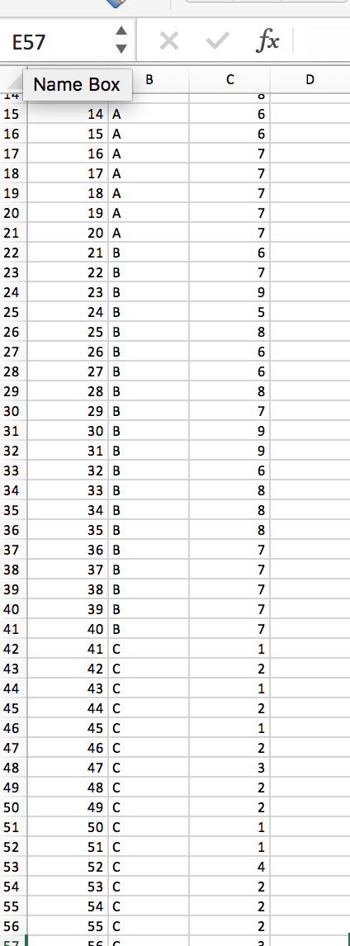
Group C: “slap”
I made up some data

Slide 185
R
# Find the mean of each group
dat = read.csv("HCIXP-anova.csv", header = TRUE)
cdat <- ddply(dat, "group", summarise, score.mean=mean(score))
cdat
group score.mean
1 A 6.60
2 B 7.25
3 C 1.95
# Overlaid histograms with means
ggplot(dat, aes(x=score, fill=group)) + geom_histogram(binwidth=1, alpha=.3, position="identity") + geom_vline(data=cdat, aes(xintercept=score.mean, colour=group), linetype="dashed", size=1) + expand_limits(x = 0, y = 0)
Notes:
head(cars) # cars is a table that already comes with R and contain 50 observations of speed and distance in two rows
scatter.smooth(x=cars$speed, y=cars$dist, main="Dist ~ Speed") # scatterplot
linearMod <- lm(dist ~ speed, data=cars) # build linear regression model on full data
summary(linearMod) # summary(linearMod)$r.squared
abline(linearMod, col="blue")

Slide 186
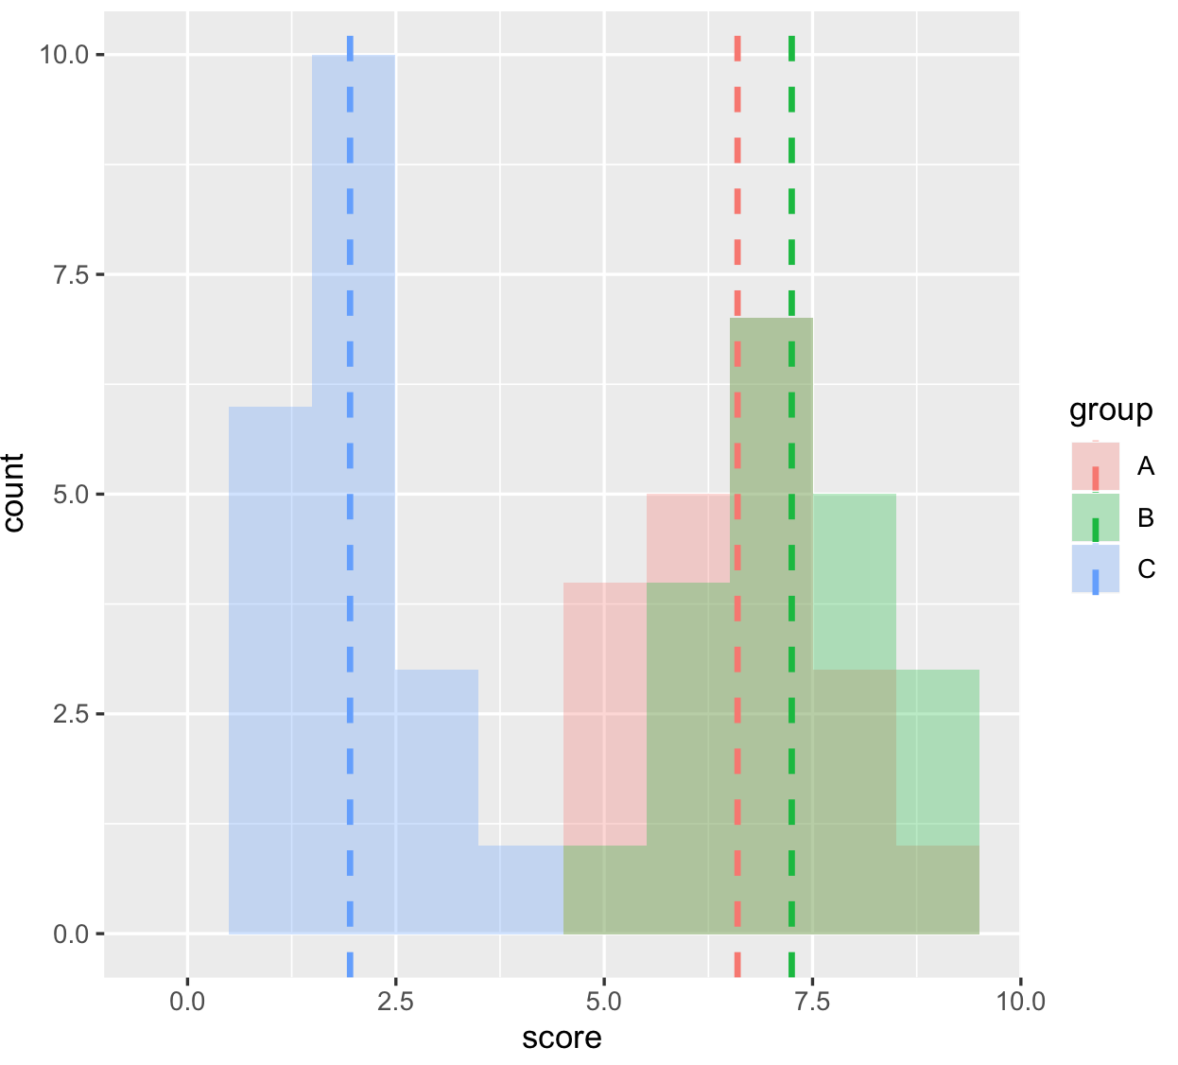
your gut feeling: are these groups different?
are these distributions likely to have happen by chance?

Slide 187
can we use t-tests?
(3 tests to compare group 1 with 2, 2 with 3 and 1 with 3)
-> yes but use Bonferoni correction
significance level not 0.05 anymore but 0.05 / number of comparisons performed (here 3) so 0.016

Slide 188
R
# Use a t-test (two-tails, unpaired)
# (we already know A vs B not significative) so we need to do
t.test(dat$score[dat$group == "A"], dat$score[dat$group == "C"], alternative = "two.sided")
t = 14.753, df = 34.591, p-value < 2.2e-16
# and
t.test(dat$score[dat$group == "B"], dat$score[dat$group == "C"], alternative = "two.sided")
t = 17.054, df = 34.971, p-value < 2.2e-16
In both case p_value < 0.016 so we can conclude!
Notes:
head(cars) # cars is a table that already comes with R and contain 50 observations of speed and distance in two rows
scatter.smooth(x=cars$speed, y=cars$dist, main="Dist ~ Speed") # scatterplot
linearMod <- lm(dist ~ speed, data=cars) # build linear regression model on full data
summary(linearMod) # summary(linearMod)$r.squared
abline(linearMod, col="blue")

Slide 189
Another test we can use when we have more than two groups to compare is an ANOVA
we have 3 different conditions (or 1 factor with 3 different levels) so we will do a one-way ANOVA

Slide 190
anova::
analyze of variance to compare multiple variables
one-way anova = one variable with multiple levels
two-way anova = two variables with multiple levels

Slide 191
R
# first we run the one-way anova
library(ez)
ezANOVA(dat,id,between=group,dv=score)
Effect DFn DFd F p p<.05 ges
1 group 2 57 154.8886 9.056612e-24 * 0.8445923
# second, run the pairwise comparison
pairwise.t.test(dat$score,dat$group, paired=FALSE, p.adjust.method="bonferroni")
A B
B 0.16 -
C <2e-16 <2e-16
ok something is going
to be interesting here
here are significant differences
and we don’t need to do the Bonferroni correction (already included)
Notes:
head(cars) # cars is a table that already comes with R and contain 50 observations of speed and distance in two rows
scatter.smooth(x=cars$speed, y=cars$dist, main="Dist ~ Speed") # scatterplot
linearMod <- lm(dist ~ speed, data=cars) # build linear regression model on full data
summary(linearMod) # summary(linearMod)$r.squared
abline(linearMod, col="blue")

Slide 192
we can write:
“A one-way ANOVA showed a significant effect on time for the variable Group ( F2,57=154.88, p < 0.05).”
and then:
“Post-hoc comparison t-tests (using Bonferoni correction) showed significant difference between the group C and the group A (p<0.05) and between group C and group B (p<0.05).”
<you could also give means values to give more info>

Slide 193
one last thing you could find useful: how to make a graph with confident interval

Slide 194
R
# first we run the one-way anova
library(Rmisc)
tgc <- summarySE(dat, measurevar="score", groupvars=c("group"))
tgc
group N score sd se ci
1 A 20 6.60 1.1424811 0.2554665 0.5346976
2 B 20 7.25 1.1180340 0.2500000 0.5232560
3 C 20 1.95 0.8255779 0.1846048 0.3863824
ggplot(data = tgc, aes(x = tgc$group, y = tgc$score)) + geom_bar(stat = 'identity', position = 'dodge') + geom_errorbar(aes(ymin= tgc$score - ci, ymax= tgc$score + ci), width=.2, position=position_dodge(.9))
Notes:
head(cars) # cars is a table that already comes with R and contain 50 observations of speed and distance in two rows
scatter.smooth(x=cars$speed, y=cars$dist, main="Dist ~ Speed") # scatterplot
linearMod <- lm(dist ~ speed, data=cars) # build linear regression model on full data
summary(linearMod) # summary(linearMod)$r.squared
abline(linearMod, col="blue")

Slide 195
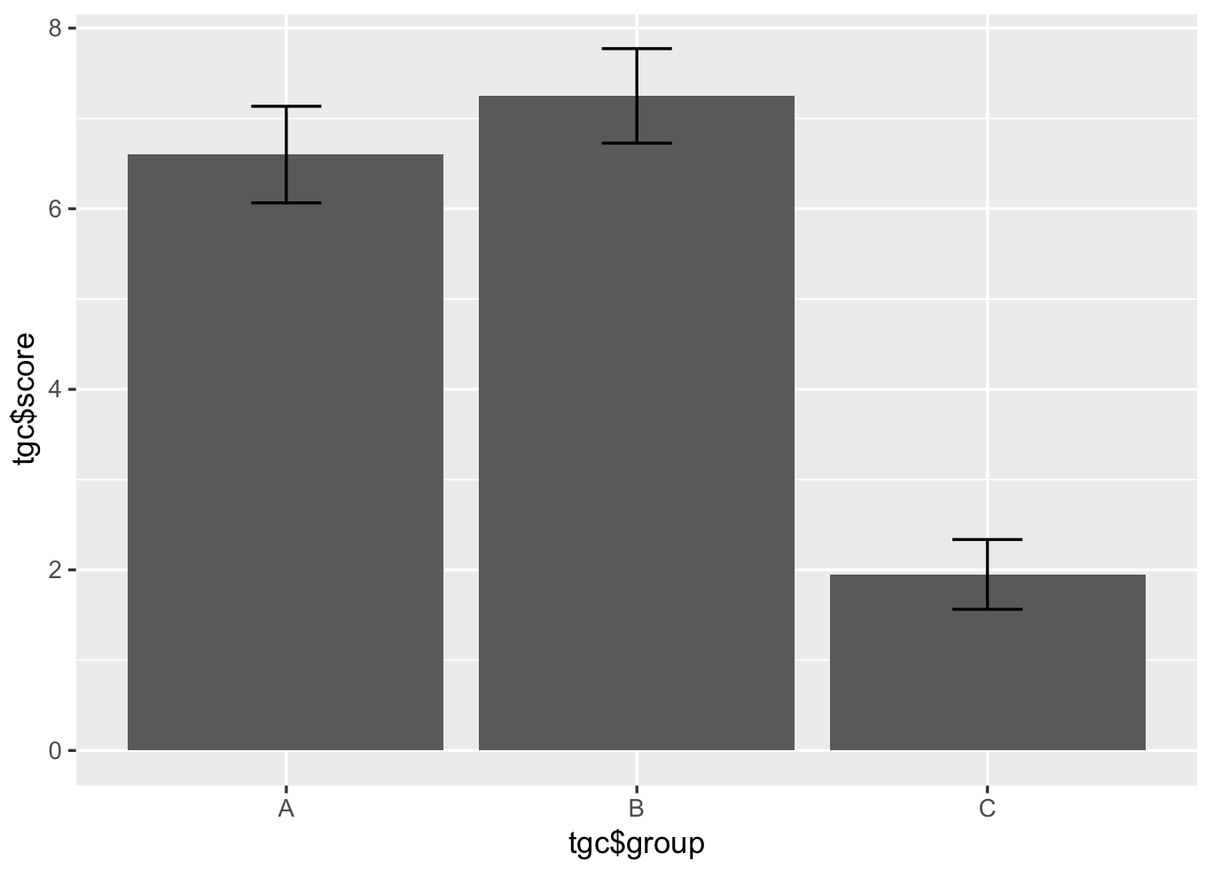

Slide 196
ok we have learned quite a lot so far!

Slide 197
1
5
research question / hypothesis?
look at raw data
2
6
in(dependent) variables?
look at distributions
3a
within or between subjects?
7a
we will see why
check for normality
3b
counterbalancing?
7b
run some stats
T-test if 2 group
ANOVA if more
4
8
how many repetitions/trials?
conclude

Slide 198
let’s talk about dependent variables

Slide 200


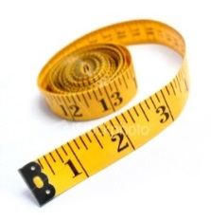


Slide 201
Q1: What is your favourite subject?
Q2: Gender:
Q3: I consider myself to be good at mathematics:
Q4: Score in a recent mock GCSE maths exam:
Maths | English | Science | Art | French
Male | Female
Strongly Disagree | Disagree | Not Sure | Agree | Strongly Agree
Score between 0% and 100%

Slide 202
Nominal
Q1: What is your favourite subject?
Q2: Gender:
Q3: I consider myself to be good at mathematics:
Q4: Score in a recent mock GCSE maths exam:
Maths | English | Science | Art | French
Male | Female
Binary/ Nominal
Strongly Disagree | Disagree | Not Sure | Agree | Strongly Agree
Ordinal
Score between 0% and 100%
Scale

Slide 203
time and error as dependent variables …

Slide 204
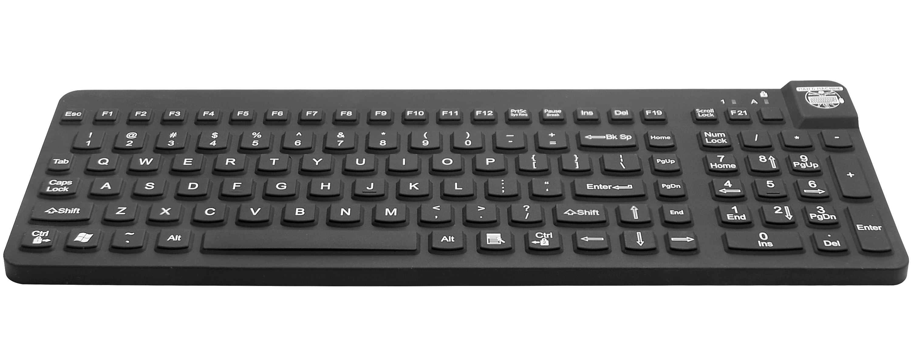
imagine an experiment:
when you hear letter, press the corresponding keys as fast as possible
if there is no penalty for error, participants just slam the keyboard randomly
→ we also need to consider error rate. → each trial is effectively a (time, error) pair

Slide 205
task time
which participant was better?
P2
P1
P1
p2 is worse than any participant in this rectangle
error

Slide 206
task time
which participant was better?
task time and error rate
form a trade-off
P1
P2
error

Slide 207
how to make sure two
conditions can be compared?
task time
4%
control error rate, e.g. pick an error rate in advance, say 4%
or keep task time constant (less common e.g. metronome study [Wobbrock & Cutrell])
P1
P2
error

Slide 208
questionnaires as dependent variables …

Slide 209
Goal is to collect information that is:
Valid
measures the quantity that is supposed to be measured
Reliable
measures the quantity in consistent/reproducible manner
Unbiased
measures the quantity in a way that does not systematically
under- or overestimate the true value
Discriminating
can distinguish adequately between respondents for whom the
underlying level of the quantity or concept is different

Slide 210
How many cups of coffee or tea do you drink in a day?
No, ask for an answer in only one dimension, separate the question into two
(1) How many cups of coffee do you drink during a typical day?
(2) How many cups of tea do you drink during a typical day?

Slide 211
What brand of computer do you own?
(A) IBM PC
(B) Apple
Avoid hidden assumptions
Make sure to accommodate all possible answers
Make each response a separate dichotomous item
Do you own an IBM PC? (Circle: Yes or No)
Do you own an Apple computer? (Circle: Yes or No)
Or allow for multiple responses
What brand of computer do you own? (Circle all that apply)
Do not own computer
IBM PC
Apple
Other

Slide 212
Have you had pain in the last week?
[ ] Never [ ] Seldom [ ] Often [ ] Very often
Make sure question and answer options match
Reword either question or answer to match
How often have you had pain in the last week?
[ ] Never [ ] Seldom [ ] Often [ ] Very Often

Slide 213
Where did you grow up?
Country
Farm
City
Avoid questions having non-mutually exclusive answers
Design the question with mutually exclusive options
Where did you grow up?
House in the country
Farm in the country
City

Slide 214
Which one of the following do you think increases a person’s chance of having a heart attack the most? (Check one.)
[ ] Smoking [ ] Being overweight [ ] Stress
Encourage to consider each possible response to avoid the uncertainty of whether a missing item may represent either an answer that does not apply or an overlooked item
Which of the following increases the chance of having a heart attack?
Smoking: [ ] Yes [ ] No [ ] Don’t know
Being overweight: [ ] Yes [ ] No [ ] Don’t know
Stress: [ ] Yes [ ] No [ ] Don’t know

Slide 215
On a scale from 1 to 5, how fun did you have using our new system?
1. not at all 2. Not really 3.undecided 4. somewhat 5. very much
Avoid biased questions
Design the question with mutually exclusive options
On a scale from 1 to 5, how would you rate your experience with our new system?
1. not fun at all 2. Not really fun 3.undecided 4. somewhat fun 5. very much fun

Slide 216
Rank from 1 to 3 your preference in beverage
[ ] Tea [ ] Coffee [ ] Orange Jus
Avoid ranking at all cost and rather use Likert scales
On a scale from 1 to 5 rate how much you like the following beverages
Tea: 1. not at all 2. Not really 3.undecided 4. somewhat 5. very much
Coffee: 1. not at all 2. Not really 3.undecided 4. somewhat 5. very much
Orange jus: 1. not at all 2. Not really 3.undecided 4. somewhat 5. very much

Slide 217
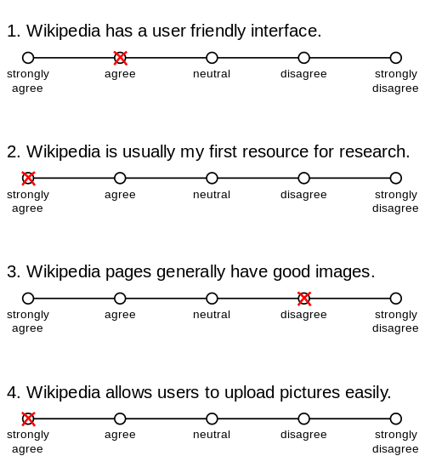
if you want to collect subjective metric such as opinions, use Likert Scale = ordinal but treated as continuous variable

Slide 218
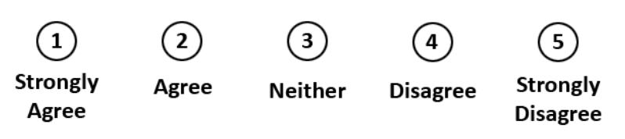
Likert scale::
psychometric response scale primarily used in questionnaires to obtain participant’s preferences or degree of agreement with a statement (generally 5pt likert scale, also 7pt)

Slide 219
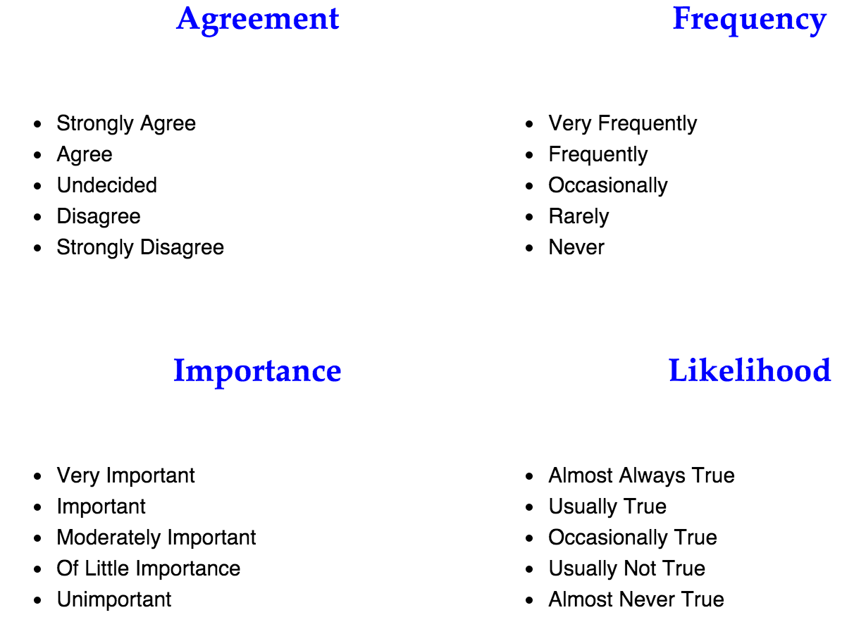

Slide 220
Likert are Ordinal but can be treated as Continuous !!!!!!!

Slide 221
ok so there are many type of data and so what?

Slide 222
so far we played with data (time, errors, memo)
that tends to follow curve of normal distribution (typical of human performances)
you could also deal with data
that tends not to follow a normal distribution (e.g. Likert scale surveys)

Slide 223

bad news: we cannot use Ttest and Anova

Slide 224
use parametric tests (ttest, anova)
so far we played data (time, errors, memo)
that tends to follow curve of normal distribution (typical of human performances)
you could also deal with data
that tends not to follow a normal distribution (e.g. Likert scale surveys)
use non-parametric tests

Slide 225
continuous independent variable
What type of data?
discrete independent variable
continuous dependent variable
discrete dependent variable
Continuous dependent variable
Discrete/categorical dependent variable
regressions
logistic
regressions
normally distributed
skewed
2 grp
>2 grp
2 grp
>2 grp
2 grp
>2 grp
Non paired
paired
Non paired
paired
Non paired
paired
Non paired
paired
Counts >= 5 in >= 75% cells
Counts >= 5 in < 75% cells
T-test
ANOVA
Mann-Whitney Utest
Wilcoxon signed rank test
Kruskall-Wallis test
Chi-square test
Fisher’s exact test
Chi-square test
Paired-t-test
Friiedman test
McNemar’s test

Slide 226
the best thing to do is to test if your data follow a normal distribution or not first before running the stats
… we will look at this in two lectures

Slide 227
take away
Explain the eight steps to design and analyze an experiment
Explain what is a within or between subject experiment
Explain what is a controlled variable or a confounding variable
Explain the difference between correlation and causality
Identify different types of variables
Understand when to use a t-test, when to use an Anova
Explain what is a Likert scale in questionnaires
Explain when to use non-parametric tests

Slide 228
4
parametric tests

Slide 229
continuous independent variable
What type of data?
discrete independent variable
continuous dependent variable
discrete dependent variable
Continuous dependent variable
Discrete/categorical dependent variable
regressions
logistic
regressions
normally distributed
skewed
2 grp
>2 grp
2 grp
>2 grp
2 grp
>2 grp
Non paired
paired
Non paired
paired
Non paired
paired
Non paired
paired
Counts >= 5 in >= 75% cells
Counts >= 5 in < 75% cells
T-test
ANOVA
Paired-t-test
Mann-Whitney Utest
Wilcoxon signed rank test
Kruskall-Wallis test
Chi-square test
Fisher’s exact test
Chi-square test
Friiedman test
McNemar’s test
we are still at this part of the graph

Slide 230
lets go back to our memorization experience

Slide 231
no evidences for chocolate vs. baseline (p>0.05)

Slide 232
count
memorization score
no evidences for chocolate vs. baseline (p>0.05)
(let’s just assume these are normally distributed)

Slide 233
count
probably
p<0.05
memorization score
if the mean where further apart, it would increase our chances to have a p<0.05

Slide 234
count
memorization score
<without changing the means, what else can we do to these data to make some more different?>

Slide 235
count
probably
p<0.05
memorization score
if the distributions where less spread out, it would increase our chances to have a p<0.05

Slide 236
count
signal
memorization score
noise
the goal of a study is to find
a signal in a lot of noise

Slide 237
any statistical tests ::
signal
noise

Slide 238
signal
T-tests ::
noise
difference between group means
variability of groups

Slide 239
signal
noise
T-tests ::
difference between group means
variability of groups

Slide 240
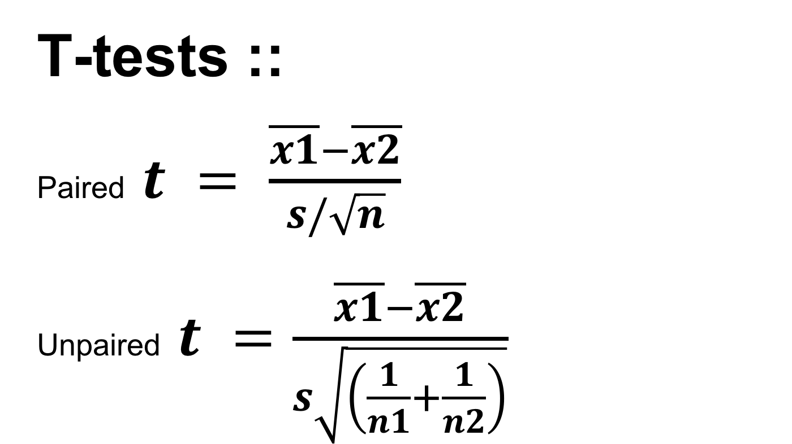
T-tests ::
Paired $t = \frac{\overline{x1}−\overline{x2}}{s/\sqrt{n}}$
Unpaired $t =\frac{\overline{x1}−\overline{x2}}{s\sqrt{\left(\frac{1}{n1}+\frac{1}{n2}\right)}}$

Slide 241
paired t-test

Slide 242
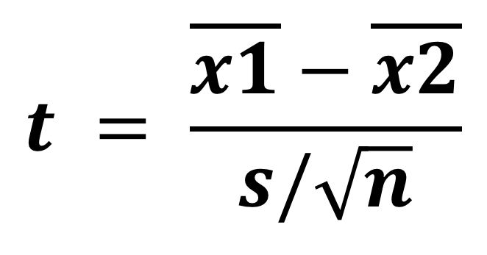
different between group means
(to maximize)
$$t = \frac{\overline{x1}−\overline{x2}}{s/\sqrt{n}}$$
standard deviation
of the differences
(to minimize)

Slide 243
different between group means
(to maximize)
$$t = \frac{\overline{x1}−\overline{x2}}{s/\sqrt{n}}$$
standard error of the mean
(to minimize)
but why do we need to divide by $\sqrt{n}$ (n = sample size)?

Slide 244
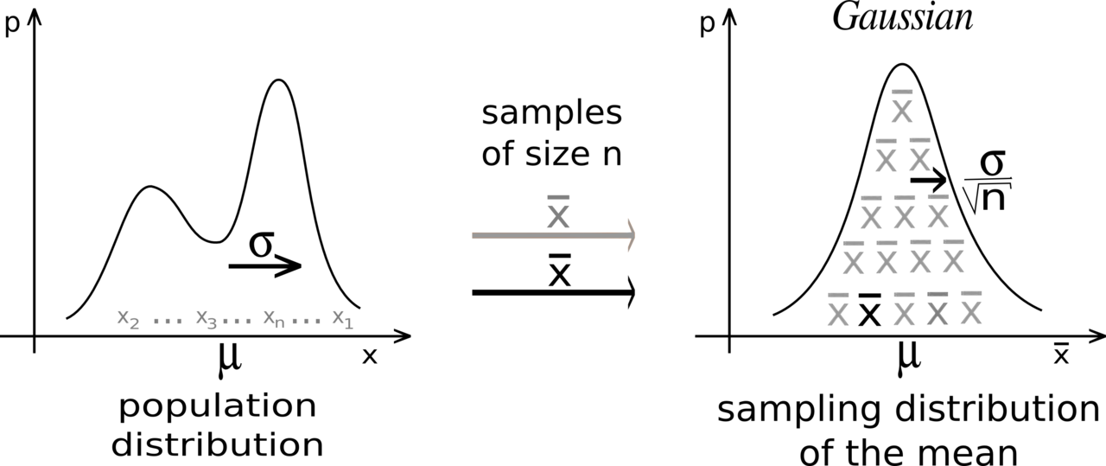
this comes from the central limit theorem you have seen before (lecture 10)

Slide 245
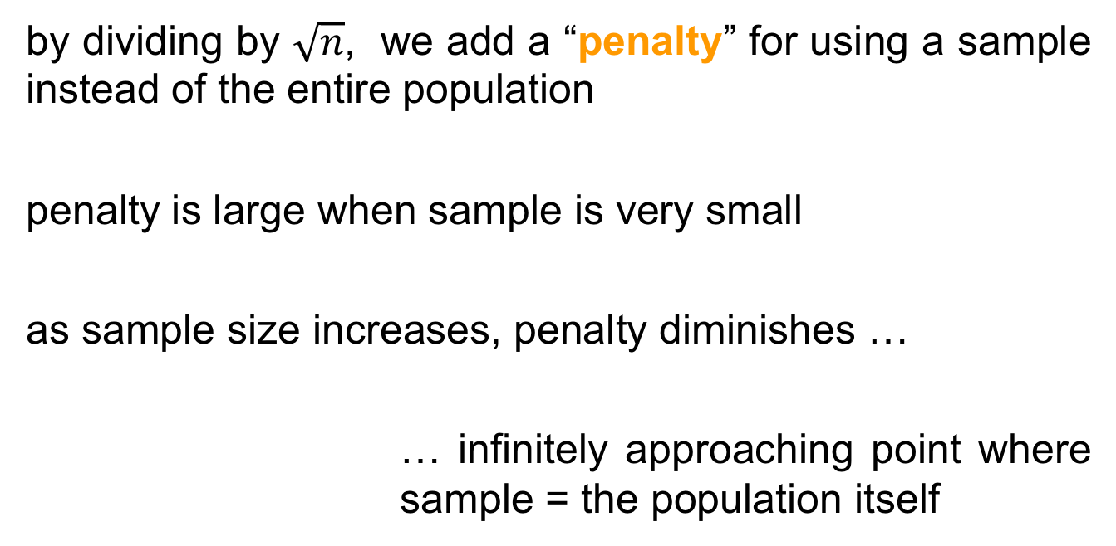
by dividing by $\sqrt{n}$, we add a “penalty” for using a sample instead of the entire population
penalty is large when sample is very small
as sample size increases, penalty diminishes …
… infinitely approaching point where sample = the population itself

Slide 246
$$t = \frac{\overline{x1}−\overline{x2}}{s/\sqrt{n}}$$
we get a t-value
(to maximize)

Slide 247
both signal and noise are in the units of your data
If signal = 6 and noise = 2, your t-value = 3, so the difference is 3 times the size of the standard error
If signal = 6 and noise = 6, your t-value = 1, the signal is at the same scale as the noise
t-values = how distinguishable signal from noise

Slide 248
how do we know our t-value is any good, and how does this related to p-value?
this is where t-distributions come in

Slide 249
studyX
study1
t=0.9
t=1.5
population
study2
…
t=1.4
study4
study3
t=1.1
t=0.9
now let’s take all these possible values and …
Notes:
When you perform a t-test for a single study, you obtain a single t-value. However, if we drew multiple random samples of the same size from the same population and performed the same t-test, we would obtain many t-values and we could plot a distribution of all of them

Slide 250
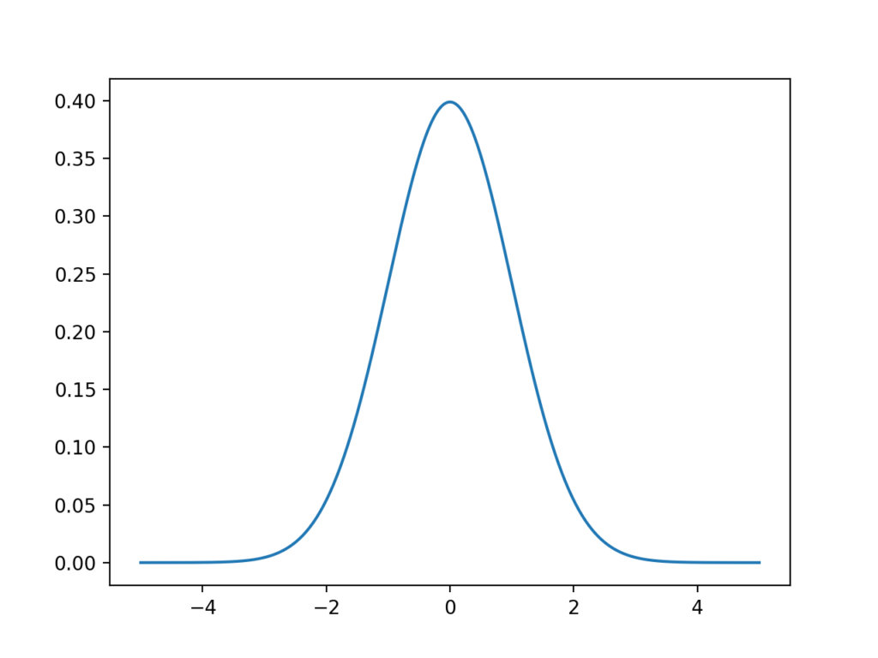
t-value
… plot a distribution of them
this type of distribution is a sampling distribution

Slide 251
fortunately, the properties of t-distributions are well understood in statistics, so we can plot them without having to collect many samples!
a specific t-distribution is defined by its degrees of freedom (DF), a value closely related to sample size (here n-1)
different t-distributions exist for every sample size

Slide 252
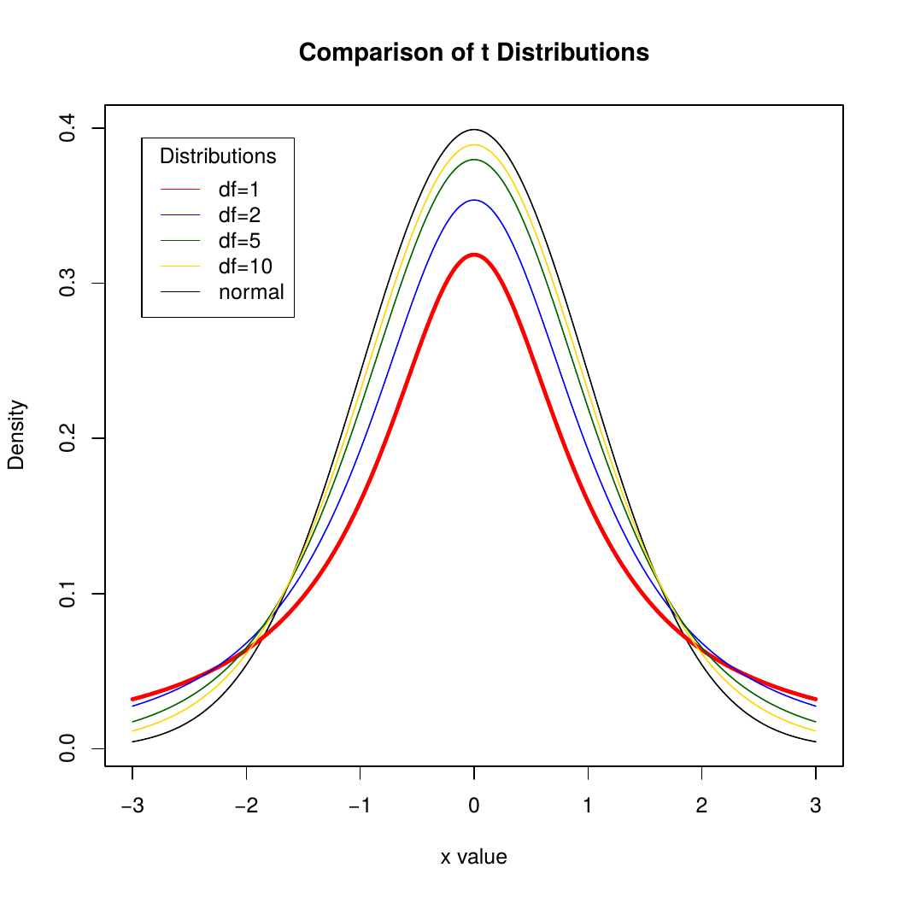
t-value

Slide 253
t-distributions assume that you draw repeated random samples from a population where the null hypothesis is true. You place the t-value from your study in the t-distribution to determine how consistent your results are with the null hypothesis.

Slide 254
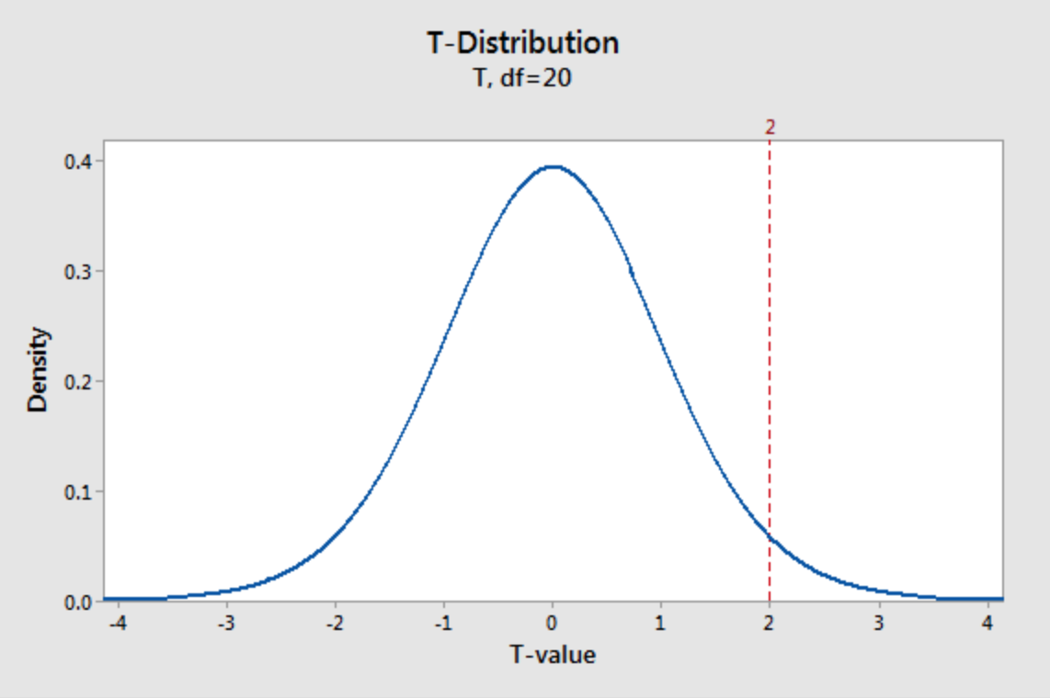
imagine a t-value of 2
seems unusual but how exactly unusual?
e.g. here a t-distribution (DF =20 which means a sample size of 21). It plots the probability density function (PDF), which describes the likelihood of each t-value.

Slide 255
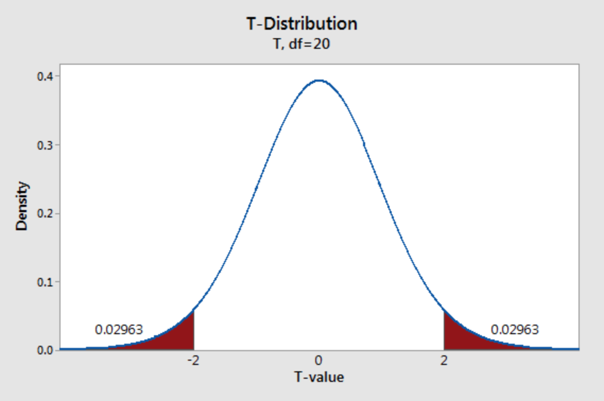
shade the area of the curve with t-values >2 and <-2
each regions has a probability of 0.02963, which sums to a total probability of 0.05926.

Slide 256
when the null hypothesis is true, the t-value falls within these regions nearly 5.9% of the time …
… this is our pvalue!

Slide 257
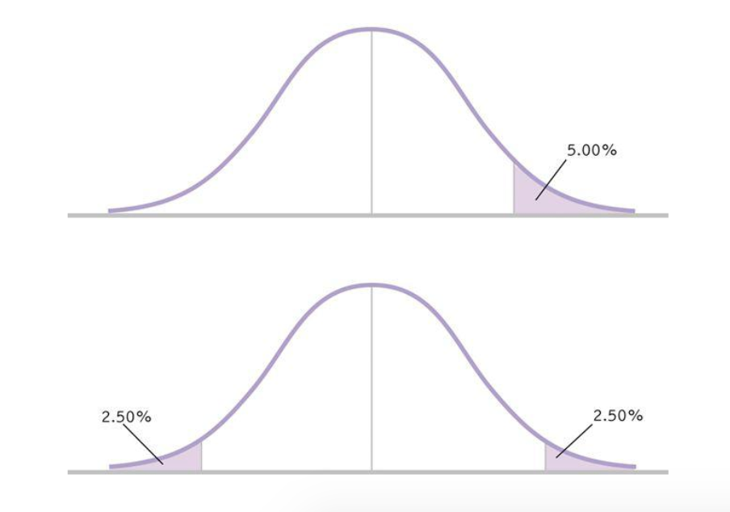
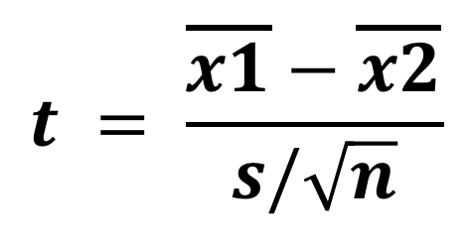
one-tail
$$t = \frac{\overline{x1}−\overline{x2}}{s/\sqrt{n}}$$
two-tails
it also does explain one-tail vs. two tails t-tests: one-tail only case about t=2 (not -2 or oppositely), so multiply pvalue by two.

Slide 258
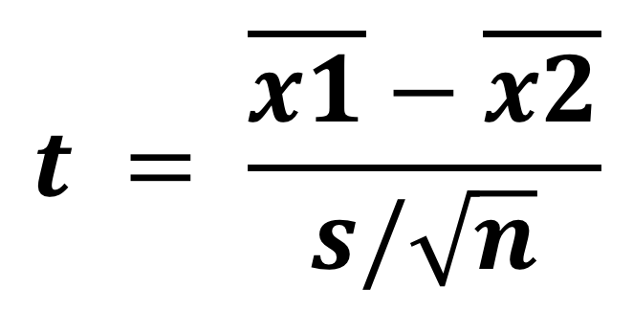
at this point you understand more the three reasons of a low p_value (or t_value)
1. difference not large enough
(what you are searching for, your signal is weak)
$$t = \frac{\overline{x1}−\overline{x2}}{s/\sqrt{n}}$$
2. too much noise
(could your experimental design introduce noise? Check it)
3. not enough data
(run more participants, gather more trials)

Slide 259
how much data is enough?

Slide 260
the larger the sample size, the more t-distributions become a z-distribution (at around n=30), the less the area under the curve to reach a low p_value.

Slide 261
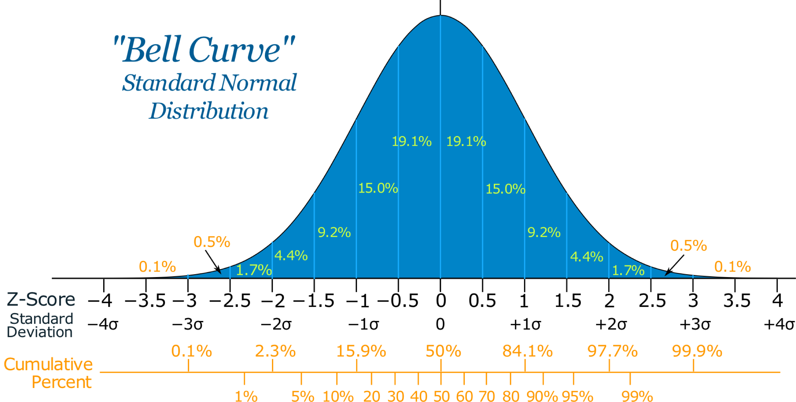
back to using a Z-score (i.e. number of standard deviations from the mean on normal distribution)

Slide 262
so why using a t-test then?
well there are cases when we want to use less sample to speed up the evaluation
this was the case of William Sealy Gosset …

Slide 263
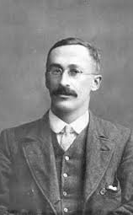

Employee of Guiness, Gosset developed a small sample method to select the best yielding varieties of barley.
Biometricians like Pearson typically had hundreds of observations.
Guinness allowed him to publish his method under the name “Student” to prevent disclosure of confidential information.
Where do t-distrubitions came from?
https://www.youtube.com/watch?v=NvUDvmrd6fo&feature=youtu.be

Slide 264
now it does not mean that 2 sample is enough … a rule of thumb for a simple within experiment is 12-16 participants for example (and twice more for between experiment).
… we will actually look at how to know if you sample size is good in the lecture 18

Slide 265
unpaired t-test

Slide 266
T-tests ::
Paired $t = \frac{\overline{x1}−\overline{x2}}{s/\sqrt{n}}$
Unpaired $t =\frac{\overline{x1}−\overline{x2}}{s\sqrt{\left(\frac{1}{n1}+\frac{1}{n2}\right)}}$
similar than paired t-test except this

Slide 267
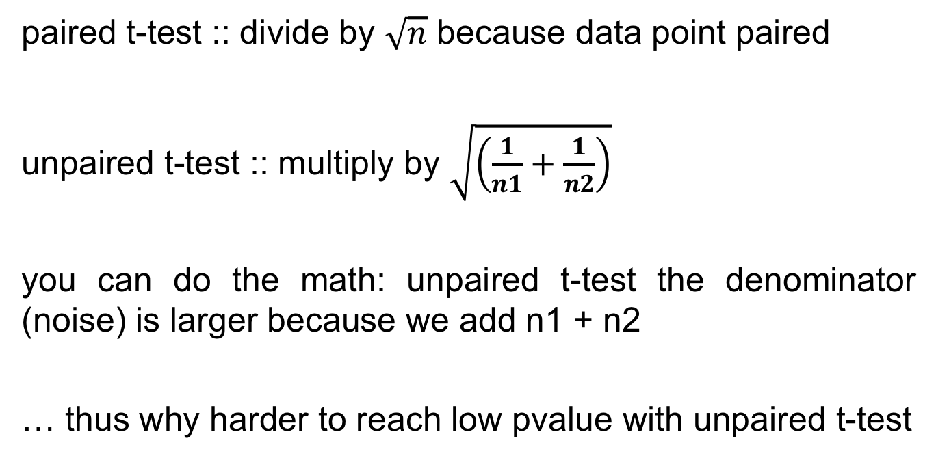
paired t-test :: divide by $\sqrt{n}$ because data point paired
unpaired t-test :: multiply by $\sqrt{\left(\frac{1}{n1}+\frac{1}{n2}\right)}$
you can do the math: unpaired t-test the denominator (noise) is larger because we add n1 + n2
… thus why harder to reach low pvalue with unpaired t-test

Slide 268
practically

Slide 269
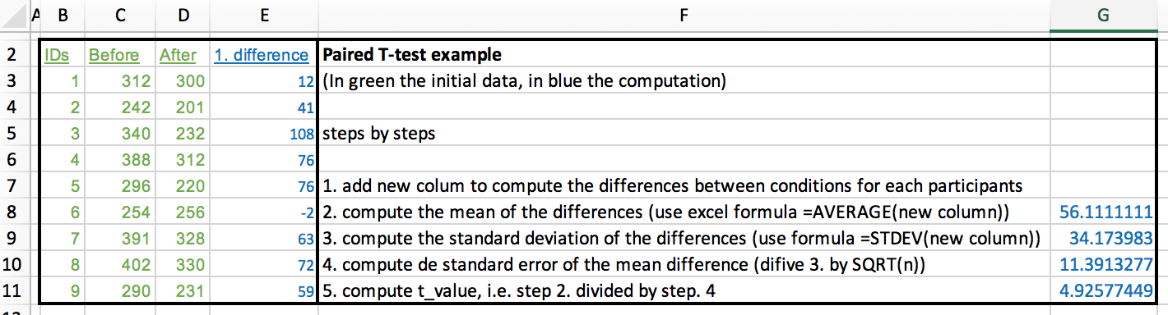
(excel file in the git hub repository)

Slide 270
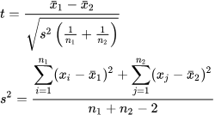
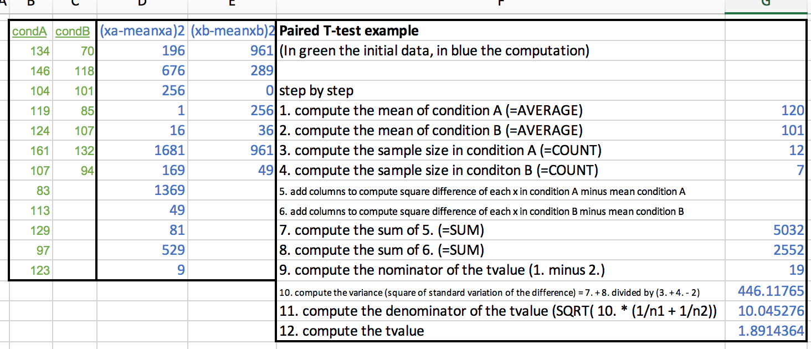
(excel file in the git hub repository)

Slide 271
anovas

Slide 273
count
memorization score
(let’s assume again these are normally distributed)

Slide 274
any statistical tests ::
signal
noise

Slide 275
signal
ANOVA ::
noise
difference between group means
variability of groups

Slide 276
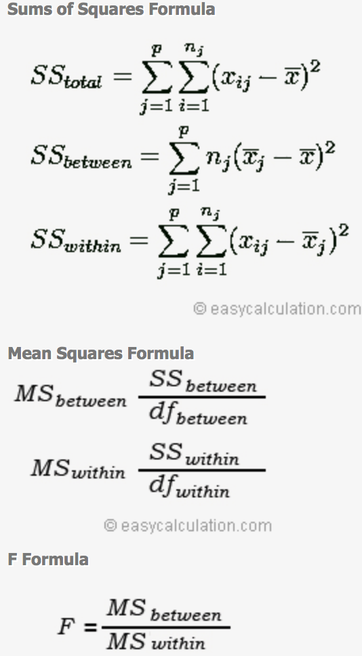
ANOVA ::

Slide 277
don’t be afraid by this

Slide 278
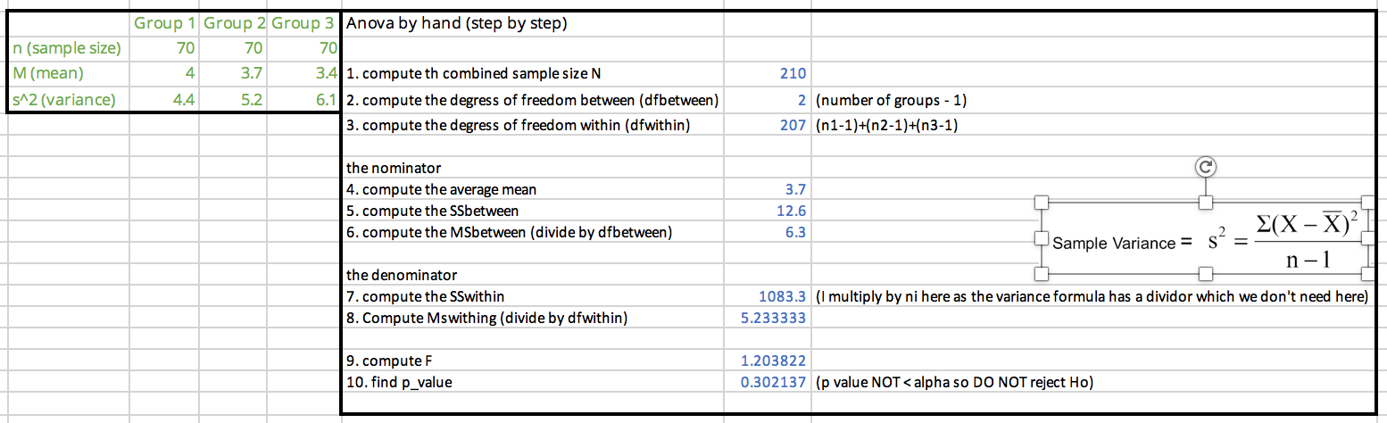
(excel file in the git hub repository)

Slide 279
how do we know if the Fvalue is anygood?
… this is where F-distributions come in

Slide 280
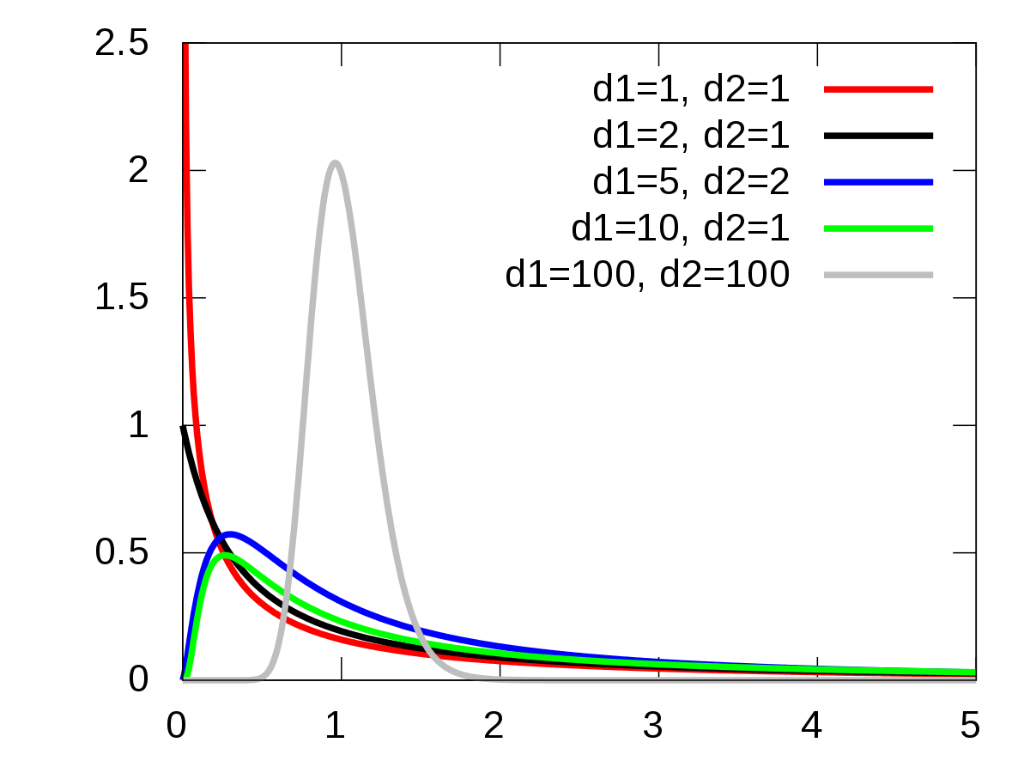
they take two degrees of freedom rather than just one like with t-distributions

Slide 281
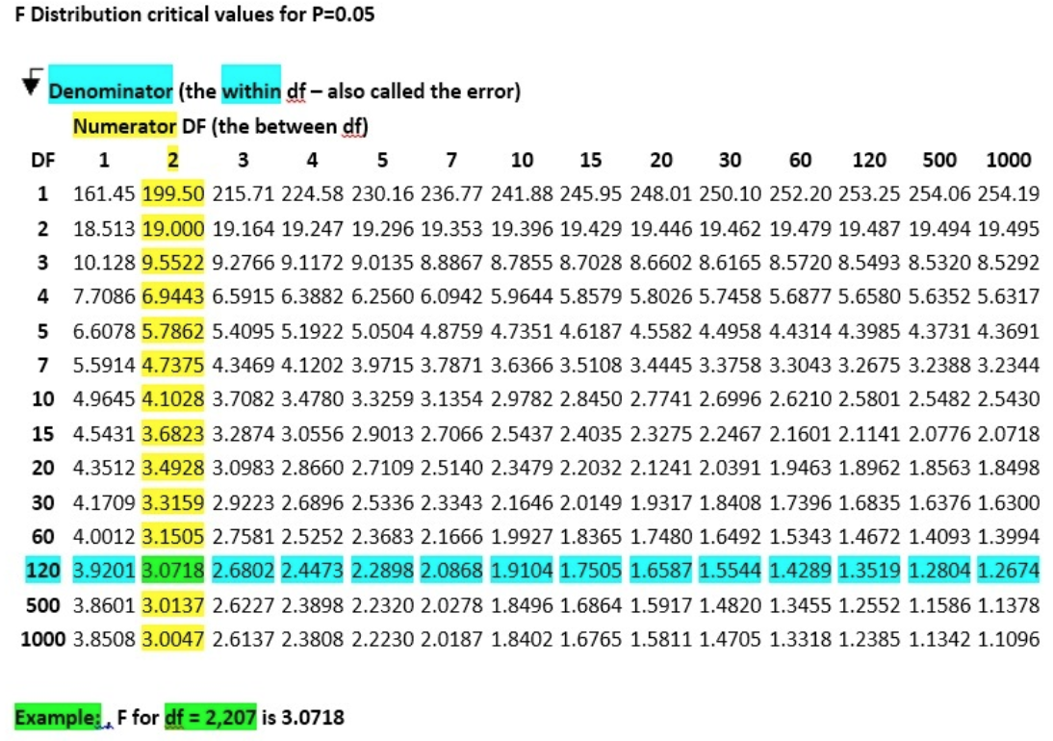
also in form of table (here for the dfwithin and dfbetween of our excel example)

Slide 282
R
# first we run the one-way anova
library(ez)
ezANOVA(dat,id,between=group,dv=score)
Effect DFn DFd F p p<.05 ges
1 group 2 57 154.8886 9.056612e-24 * 0.8445923
# second, run the pairwise comparison
pairwise.t.test(dat$score,dat$group, paired=FALSE, p.adjust.method="bonferroni")
A B
B 0.16 -
C <2e-16 <2e-16
ok something is going
to be interesting here
here are significant differences
and we don’t need to do the Bonferroni correction (already included)
this was from last week, R gives us all this numbers
Notes:
head(cars) # cars is a table that already comes with R and contain 50 observations of speed and distance in two rows
scatter.smooth(x=cars$speed, y=cars$dist, main="Dist ~ Speed") # scatterplot
linearMod <- lm(dist ~ speed, data=cars) # build linear regression model on full data
summary(linearMod) # summary(linearMod)$r.squared
abline(linearMod, col="blue")

Slide 283
degrees of freedom

Slide 284
degrees of freedom::
the number of values in the final calculation of a statistic that are free to vary
a complex notion but here is the intuition …

Slide 285
you have 7 hats, you want to wear one different every day for a week
Monday: 7 choices
Tuesday: 6 choices
Wednesday: 5 choices
Thursday: 4 choices
Friday: 3 choices
Saturday: 2 choices
Sunday: NO choice
degrees of freedom is 7-1

Slide 286
if we have 7 observations and the mean of these observation (that you need to do t-test or Anova) your degree of freedom is 7-1
because if you know 6 observations you automatically know the 7th one (thanks to the mean)

Slide 287
remember the lecture on regression?

Slide 288
1
standard error of the estimate
T time
(ms)
Fitts! T = 2.3 + 1.1 ID
ˆ
∑ (estimated y – actual y)²
(sample size-2)
ID index of difficulty
also called degree of freedom

Slide 289
a simple (approximate) way to understand this is that we have two variables, the slope and the intercept of the regression line
that give us extra information, thus the minus 2

Slide 290
take away
Explain the general equation of a statistical test (signal/noise)
Explain how a t-test is computed and be able to do it by hand
Explain the 3 reasons why a t-value can be low (signal too low, noise too high, small sample)
Explain how a Anova is computed, and be able to do it by hand
Explain what are t-distributions and f-distributions

Slide 291
5
normality
tests

Slide 292
continuous independent variable
What type of data?
discrete independent variable
continuous dependent variable
discrete dependent variable
Continuous dependent variable
Discrete/categorical dependent variable
regressions
logistic
regressions
normally distributed
skewed
2 grp
>2 grp
2 grp
>2 grp
2 grp
>2 grp
Non paired
paired
Non paired
paired
Non paired
paired
Non paired
paired
Counts >= 5 in >= 75% cells
Counts >= 5 in < 75% cells
T-test
ANOVA
Mann-Whitney Utest
Wilcoxon signed rank test
Kruskall-Wallis test
Chi-square test
Fisher’s exact test
Chi-square test
Paired-t-test
Friiedman test
McNemar’s test
we are looking at this now

Slide 293
how to::
test if data is normally distributed
use alternatives to non-parametric tests if data not normally distributed
other verifications (assumptions) we need to do on data prior to doing certain statistical tests

Slide 294
assumption of normality

Slide 295
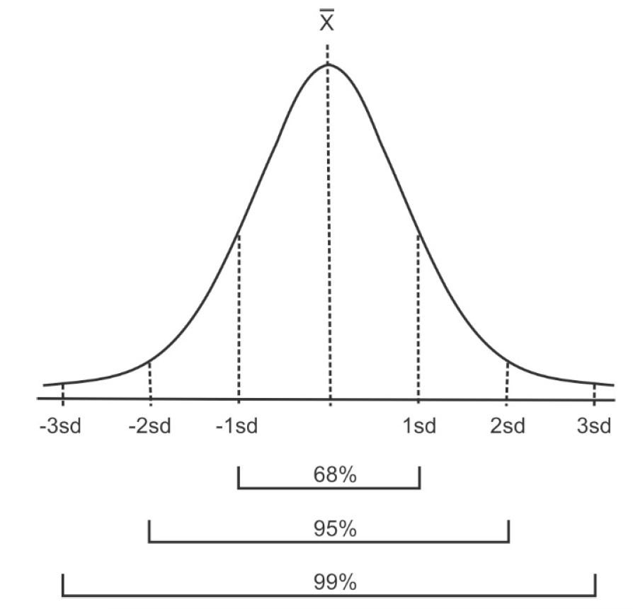
given the mean and standard deviation of a dataset = a theoretical normal distribution has those proportions

Slide 296

this theoretical normal distribution can then be compared to the actual distribution of the data.
<are the actual data statistically different than the computed normal curve? >

Slide 297
several methods to check that, we are only going to look at some of them: Q-Q probability plots, Kolmogorov-Smirnov test and Shapiro-Wilks test
(some others: W/S test, Jarque-Bera test, D’Agostino test)

Slide 298

1
Quantile Quantile Probability Plots
if the two sets come from a population with the same distribution, the points should fall along a line
it is a plot of the quantiles of the first data set against the quantiles of the second data set

Slide 299
3.89 4.75 6.33 4.75 7.21 5.78 5.80 5.20 7.90
does the following sample comes from a normality distributed population?
1. order the data:
3.89 4.75 4.75 5.20 5.78 5.80 6.33 7.21 7.90
2. plot these against appropriate quantile from the standard normal distribution
… let’s look at this in detail

Slide 300

here a standard normal distribution truncated at -3 and 3
3. search for nine values on the normal distribution = split it in 10 areas
and here our nine sample values
3.89 4.75 4.75 5.20 5.78 5.80 6.33 7.21 7.90

Slide 301
here a standard normal distribution truncated at -3 and 3
each area under the curve is 1
1
1
1
1
1
1
1
1
1
1
3. search for nine values on the normal distribution = split it
in 10 areas
4. find the values that makes that happen
and here our nine sample values
3.89 4.75 4.75 5.20 5.78 5.80 6.33 7.21 7.90

Slide 302
here a standard normal distribution truncated at -3 and 3
each area under the curve is 1
1
1
1
1
1
1
1
1
1
1
-1.28 -0.84 -0.52 -0.25 0 0.25 0.52 0.84 1.28
and here our nine sample values
3.89 4.75 4.75 5.20 5.78 5.80 6.33 7.21 7.90
Notes:
So we are gonna plot the smallest value in our sample of size nine
Against what we would expect to get as the smaller value in a sample of the same size from the standard normal distribution

Slide 303
5. plot smallest value in our sample of size nine against what we expect to get as the smaller value in a sample of the same size from the standard normal distribution … we do that for all pairs
here what we would expect to get
-1.28 -0.84 -0.52 -0.25 0 0.25 0.52 0.84 1.28
and here our nine sample values
3.89 4.75 4.75 5.20 5.78 5.80 6.33 7.21 7.90
Notes:
y <- c(3.89, 4.75, 6.33, 4.75, 7.21, 5.78, 5.80, 5.20, 7.90)
qqnorm(y)
qqline(y)
data <- c(3.89, 4.75, 4.75, 5.20, 5.78, 5.80, 6.33, 7.21, 7.90)
expected <- c(-1.28, -0.84, -0.52, -0.25, 0, 0.25, 0.52, 0.84, 1.28)

Slide 304


Slide 305
R
data <- c(3.89, 4.75, 4.75, 5.20, 5.78, 5.80, 6.33, 7.21, 7.90)
# generate expected from normal distribution
u=seq(0.1,0.9,by=0.1)
expected <- qnorm(u)
print(expected)
[1] -1.2815516 -0.8416212 -0.5244005 -0.2533471 0.0000000 0.2533471 0.5244005
[8] 0.8416212 1.281551
plot(expected,data)
#or simpler:
qqnorm(data)
qqline(data)

Slide 306

Q-Q plots are great graphical tools for large sample but not very useful for small sample size, e.g. this is the histogram of the last example: data do not ‘look’ normal, but they are not statistically different than normal.

Slide 307
statistical tests for normality are more precise since actual probabilities are calculated
Kolmogorov-Smirnov
works best for data sets with n > 50
not sensitive to problems in the tails
Shapiro-Wilks
works best for data sets with n < 50
doesn't work well if several values are same

Slide 308

2
Kolmogorov-Smirnov test
cumulative distribution function observed
cumulative distribution function expected
can generate a p-value

Slide 309
0.16 -0.68 -0.32 -0.85 0.89 -2.28 0.63 0.41 0.15 0.74
1.30 -0.13 0.80 -0.75 0.28 -1.00 0.14 -1.38 -0.04 -0.25
-0.17 1.29 0.47 -1.23 0.21 -0.04 0.07 -0.08 0.32 -0.17
0.13 -1.94 0.78 0.19 -0.12 -0.19 0.76 -1.48 -0.01 0.20
-1.97 -0.37 3.08 -0.40 0.80 0.01 1.32 -0.47 2.29 -0.26
-1.52 -0.06 -1.02 1.06 0.60 1.15 1.92 -0.06 -0.19 0.67
0.29 0.58 0.02 2.18 -0.04 -0.13 -0.79 -1.28 -1.41 -0.23
0.65 -0.26 -0.17 -1.53 -1.69 -1.60 0.09 -1.11 0.30 0.71
-0.88 -0.03 0.56 -3.68 2.40 0.62 0.52 -1.25 0.85 -0.09
-0.23 -1.16 0.22 -1.68 0.50 -0.35 -0.35 -0.33 -0.24 0.25
does the following sample of n=100 comes from a normality distributed population?

Slide 310

intuitively, we search for the maximum absolute distance between our data cumulative distribution function and the normal cumulative distribution function

Slide 311


so far we looked at probability density function: represents probability that the variate has the value x
another way to look at this is the cumulative distribution function: represents probability that the variable takes a value less than or equal to x

Slide 312
0.16 -0.68 -0.32 -0.85 0.89 -2.28 0.63 0.41 0.15 0.74
1.30 -0.13 0.80 -0.75 0.28 -1.00 0.14 -1.38 -0.04 -0.25
-0.17 1.29 0.47 -1.23 0.21 -0.04 0.07 -0.08 0.32 -0.17
0.13 -1.94 0.78 0.19 -0.12 -0.19 0.76 -1.48 -0.01 0.20
-1.97 -0.37 3.08 -0.40 0.80 0.01 1.32 -0.47 2.29 -0.26
-1.52 -0.06 -1.02 1.06 0.60 1.15 1.92 -0.06 -0.19 0.67
0.29 0.58 0.02 2.18 -0.04 -0.13 -0.79 -1.28 -1.41 -0.23
0.65 -0.26 -0.17 -1.53 -1.69 -1.60 0.09 -1.11 0.30 0.71
-0.88 -0.03 0.56 -3.68 2.40 0.62 0.52 -1.25 0.85 -0.09
-0.23 -1.16 0.22 -1.68 0.50 -0.35 -0.35 -0.33 -0.24 0.25
does the following sample of n=100 comes from a normality distributed population?

Slide 313

1. order the data:
-3.68 -2.28 -1.97 -1.94 -1.69 -1.68 -1.60 -1.53 -1.52 -1.48
-1.41 -1.38 -1.28 -1.25 -1.23 -1.16 -1.11 -1.02 -1.00 -0.88
-0.85 -0.79 -0.75 -0.68 -0.47 -0.40 -0.37 -0.35 -0.35 -0.33
-0.32 -0.26 -0.26 -0.25 -0.24 -0.23 -0.23 -0.19 -0.19 -0.17
-0.17 -0.17 -0.13 -0.13 -0.12 -0.09 -0.08 -0.06 -0.06 -0.04
-0.04 -0.04 -0.03 -0.01 0.01 0.02 0.07 0.09 0.13 0.14
0.15 0.16 0.19 0.20 0.21 0.22 0.25 0.28 0.29 0.30
0.32 0.41 0.47 0.50 0.52 0.56 0.58 0.60 0.62 0.63
0.65 0.67 0.71 0.74 0.76 0.78 0.80 0.80 0.85 0.89
1.06 1.15 1.29 1.30 1.32 1.92 2.18 2.29 2.40 3.08
2. compute the empirical distribution function
0.01 0.02 0.03 0.04 0.05 0.06 0.07 0.08 0.09 0.10 0.11 0.12 0.13 0.14 0.15 0.16 0.17 0.18 0.19 0.20 0.21 0.22 0.23 0.24 0.25 0.26 0.27 0.28 0.29 0.30 0.31 0.32 0.33 0.34 0.35 0.36 0.37 0.38 0.39 0.40 0.41 0.42 0.43 0.44 0.45 0.46 0.47 0.48 0.49 0.50 0.51 0.52 0.53 0.54 0.55 0.56 0.57 0.58 0.59 0.60 0.61 0.62 0.63 0.64 0.65 0.66 0.67 0.68 0.69 0.70 0.71 0.72 0.73 0.74 0.75 0.76 0.77 0.78 0.79 0.80 0.81 0.82 0.83 0.84 0.85 0.86 0.87 0.88 0.89 0.90 0.91 0.92 0.93 0.94 0.95 0.96 0.97 0.98 0.99 1.00
Notes:
y<-c(0.16,-0.68,-0.32,-0.85,0.89,-2.28,0.63,0.41,0.15,0.74,1.30,-0.13,0.80,-0.75,0.28,-1.00,0.14,-1.38,-0.04,-0.25,-0.17,1.29,0.47,-1.23,0.21,-0.04,0.07,-0.08,0.32,-0.17,0.13,-1.94,0.78,0.19,-0.12,-0.19,0.76,-1.48,-0.01,0.20,-1.97,-0.37,3.08,-0.40,0.80,0.01,1.32,-0.47,2.29,-0.26,-1.52,-0.06,-1.02,1.06,0.60,1.15,1.92,-0.06,-0.19,0.67,0.29,0.58,0.02,2.18,-0.04,-0.13,-0.79,-1.28,-1.41,-0.23,0.65,-0.26,-0.17,-1.53,-1.69,-1.60,0.09,-1.11,0.30,0.71,-0.88,-0.03,0.56,-3.68,2.40,0.62,0.52,-1.25,0.85,-0.09,-0.23,-1.16,0.22,-1.68,0.50,-0.35,-0.35,-0.33,-0.24,0.25)
ysorted <- sort(y)

Slide 314

3. for each observation xi from the data, compute:
(in this case, the expected distribution function is standard normal so use the normal table)
0.01 0.02 0.03 0.04 0.05 0.06 0.07 0.08 0.09 0.10 0.11 0.12 0.13 0.14 0.15 0.16 0.17 0.18 0.19 0.20 0.21 0.22 0.23 0.24 0.25 0.26 0.27 0.28 0.29 0.30
0.31 0.32 0.33 0.34 0.35 0.36 0.37 0.38 0.39 0.40 0.41 0.42 0.43 0.44 0.45 0.46 0.47 0.48 0.49 0.50 0.51 0.52 0.53 0.54 0.55 0.56 0.57 0.58 0.59 0.60
0.61 0.62 0.63 0.64 0.65 0.66 0.67 0.68 0.69 0.70 0.71 0.72 0.73 0.74 0.75 0.76 0.77 0.78 0.79 0.80 0.81 0.82 0.83 0.84 0.85 0.86 0.87 0.88 0.89 0.90
0.91 0.92 0.93 0.94 0.95 0.96 0.97 0.98 0.99 1.00

Slide 315

now we have two tables Fobs and Fexp …
4. lets compute the absolute difference between the two and find the highest value
0.01 0.02 0.01 0.01 0.02 0.02 0.02 0.03 0.04 0.04
0.04 0.05 0.04 0.04 0.05 0.06 0.07 0.07 0.08 0.08
0.09 0.09 0.09 0.06 -0.04 -0.05 -0.05 -0.04 -0.03 -0.04
-0.03 -0.04 -0.03 -0.02 -0.01 0.00 0.01 0.01 0.02 0.03
0.04 0.05 0.03 0.04 0.05 0.06 0.06 0.06 0.07 0.08
0.09 0.10 0.11 0.12 0.11 0.12 0.12 0.13 0.13 0.11
0.12 0.12 0.13 0.14 0.15 0.16 0.17 0.18 0.19 0.19
0.18 0.12 0.11 0.10 0.11 0.10 0.08 0.09 0.08 0.09
0.09 0.09 0.10 0.10 0.10 0.11 0.11 0.12 0.13 0.11
0.06 0.06 0.04 0.05 0.06 -0.02 -0.03 -0.02 -0.01 0.00
this is the D searched

Slide 316
we have calculated the maximum absolute distance between expected and observed distribution functions

Slide 317

5. at 95% level the critical value is approximately given by
we have a sample size of n = 100 so Dcrit = 0.136
and 0.19 > 0.136

Slide 318

there is a plethora of tables / sampling distributions that are established and are the basis of all statistic tests

Slide 319
so 0.19 > 0.136 so null hypothesis rejected
H0: the samples come from a normal distribution
conclusion: the data do not come from a normal distribution
note KS is different than other tests we saw where we looked for a value below a critical level to reject the null, here it is the opposite (the larger the results the less likely is H0 so we reject it)

Slide 320
what if Dn < Dcrit?
here is a tricky bit … remember lecture on hypothesis testing, we cannot prove that two things are equal so we are going to assume that the normality is met
which is why we call this assumption of normality
more example on GitHub repository or at
http://www.real-statistics.com/tests-normality-and-symmetry/statistical-tests-normality-symmetry/kolmogorov-smirnov-test/

Slide 321
R
#sorting a table
y <-c(0.16,-0.68,-0.32,-0.85,0.89,-2.28,0.63,0.41,0.15,0.74,1.30,-0.13,0.80,-0.75,0.28,-1.00,0.14,-1.38,-0.04,-0.25,-0.17,1.29,0.47,-1.23,0.21,-0.04,0.07,-0.08,0.32,-0.17,0.13,-1.94,0.78,0.19,-0.12,-0.19,0.76,-1.48,-0.01,0.20,-1.97,-0.37,3.08,-0.40,0.80,0.01,1.32,-0.47,2.29,-0.26,-1.52,-0.06,-1.02,1.06,0.60,1.15,1.92,-0.06,-0.19,0.67,0.29,0.58,0.02,2.18,-0.04,-0.13,-0.79,-1.28,-1.41,-0.23,0.65,-0.26,-0.17,-1.53,-1.69,-1.60,0.09,-1.11,0.30,0.71,-0.88,-0.03,0.56,-3.68,2.40,0.62,0.52,-1.25,0.85,-0.09,-0.23,-1.16,0.22,-1.68,0.50,-0.35,-0.35,-0.33,-0.24,0.25)
ysorted <- sort(y)
X <- rnorm(100)
p = ecdf(X) #cumulative distribution function
X = sort(X) # trick to get fexp
fexp <- p(X)
fobs <- p(ysorted)
KS = max(abs(fexp-fobs))
Notes:
X <- rnorm(100)
p = ecdf(X)
X = sort(X)
fexp <- p(X)
fobs <- p(ysorted)
KS = max(abs(fexp-fobs))
KS
ks.test(X,y)

Slide 322
R
#or easier
ks.test(X,y)
Two-sample Kolmogorov-Smirnov test
data: X and y
D = 0.19, p-value = 0.05410262
alternative hypothesis: two-sided
#note that if you run the code you will have different D (because of the random rnorm generation) but likely that your pvalue will always be above 0.05

Slide 323
Kolmogorov-Smirnov works well with sample size > 50 but when the sample is smaller Shapiro-Wilks works best

Slide 324


3
Shapiro-Wilks test
x(i) is the ith order statistic
SS (sum of squared difference)
m1, ..., mn are the expected values of the order
statistics of independent and identically
distributed random variables sampled from the
standard normal distribution, and V is the
covariance matrix of those order statistics.
can generate a p-value

Slide 325
a bit more beefy but let’s go steps by steps …

Slide 326
3.83 3.16 4.70 3.97 2.03 2.87 3.65 5.09
does the following sample comes from a normality distributed population?
1. order the data:
2.03 2.87 3.16 3.65 3.83 3.97 4.70 5.09
2. divide them in two
2.03 2.87 3.16 3.65 3.83 3.97 4.70 5.09

Slide 327
2.03 2.87 3.16 3.65 3.83 3.97 4.70 5.09
3. compute di the differences between both
3.06
1.83
0.81
0.18
4. multiply each of these by ai

Slide 328

good new we have shapiro-wilk table
…
di
ai
=
=
=
=
3.06
1.83
0.81
0.18
0.6052
0.3164
0.1743
0.0561
1.851912
0.579012
0.141183
0.010098
*
*
*
*
total: 2.582205

Slide 329

5. Divide the total by SS
6. from the reference table of W (another table yeah!),
Wcrit(n=8 at 0.05)=0.818
and 0.983>Wcrit

Slide 330
0.983>Wcrit, so we cannot reject null hypothesis, so we assume the data follows a normal distribution
otherwise (if <) we could rejected the null hypothesis and conclude with 95% confidence that that the data are not normally distributed
note we search for value below a critical level to reject the null, this is quite different from the results using the Kolmogorov-Smirnov test where this is the opposite
more example on GitHub repository or at
http://www.real-statistics.com/tests-normality-and-symmetry/statistical-tests-normality-symmetry/shapiro-wilk-test/

Slide 331
R
y <-c(3.83, 3.16, 4.70, 3.97, 2.03, 2.87, 3.65, 5.09)
shapiro.test(y)
Shapiro-Wilk normality test
data: y
W = 0.98317, p-value = 0.9769

Slide 332
ok so we know how to check our data, now what?

Slide 333
continuous independent variable
What type of data?
discrete independent variable
we can choose between parametric (normal) or non-parametric (skewed) test
continuous dependent variable
discrete dependent variable
Continuous dependent variable
Discrete/categorical dependent variable
regressions
logistic
regressions
normally distributed
skewed
2 grp
>2 grp
2 grp
>2 grp
2 grp
>2 grp
Non paired
paired
Non paired
paired
Non paired
paired
Non paired
paired
Counts >= 5 in >= 75% cells
Counts >= 5 in < 75% cells
T-test
ANOVA
Mann-Whitney Utest
Wilcoxon signed rank test
Kruskall-Wallis test
Chi-square test
Fisher’s exact test
Chi-square test
Paired-t-test
Friiedman test
McNemar’s test

Slide 334
but if your data is not normally distributed you could also try to make it normal using transformations
… more generally because parametric tests are more robust than non-parametric ones

Slide 335
transformations

Slide 336


Slide 337
common transformations for left skewed::
square root, cube root, log

Slide 339
common transformations for right skewed::
square, cube root and logarithmic

Slide 340
R
y <-c(1.0, 1.2, 1.1, 1.1, 2.4, 2.2, 2.6, 4.1, 5.0, 10.0, 4.0, 4.1, 4.2, 4.1, 5.1, 4.5, 5.0, 15.2, 10.0, 20.0, 1.1, 1.1, 1.2, 1.6, 2.2, 3.0, 4.0, 10.5)
hist(y)
qqnorm(y)
qqline(y)
y_sqrt = sqrt(y) #cube root
y_cub = sign(y) * abs(y)^(1/3) #square root
y_log = log(y) #logarithm
# you can now try
qqnorm(y_log)
qqline(y_log)

Slide 341




square root cube root logarithmic

Slide 342
sometimes it does not work and rather than trying a complex transformations it id better to use non parametric tests
also skewed distributions could come from outliers so make sure to get rid of them!

Slide 343
other assumptions

Slide 344
assumption of normality is not the only thing we need to check, particularly when performing ANOVAs
also need to check the assumption of homogeneity

Slide 345

ANOVAs do not work well in this case

Slide 346
we can only do ANOVA if distribution are homogeneous and we can do this with the Levene’s test

Slide 347
R
# first we run the one-way anova
dat = read.csv("HCIXP-anova.csv", header = TRUE)
library(ez)
ezANOVA(dat,id,between=group,dv=score)
Effect DFn DFd F p p<.05 ges
1 group 2 57 154.8886 9.056612e-24 * 0.8445923
$`Levene's Test for Homogeneity of Variance`
DFn DFd SSn SSd F p p<.05
1 2 57 1.433333 29.3 1.394198 0.2563608

Slide 348
the levene’s test checks for homogeneity of variances (null hypothesis is that all variances are equal)
we won’t go in detail with this test but the most important is this:
if p-value < 0.05 means variances not equal and parametric tests such as ANOVA are not suited (need non-parametric tests)

Slide 349
take away
Give the names of tests we can use to check normality and explain their differences and when to use them
I will not ask you to them by hand in the exam
Explain what to do if the data are not normal (either transforming the data or using non-parametric tests)
Explain what is the goal of a test of homogeneity of variance and what to do if the variances are not equal

Slide 350
6
non-parametric
tests

Slide 351
continuous independent variable
What type of data?
discrete independent variable
we are looking at this now
continuous dependent variable
discrete dependent variable
Continuous dependent variable
Discrete/categorical dependent variable
regressions
logistic
regressions
normally distributed
skewed
2 grp
>2 grp
2 grp
>2 grp
2 grp
>2 grp
Non paired
paired
Non paired
paired
Non paired
paired
Non paired
paired
Counts >= 5 in >= 75% cells
Counts >= 5 in < 75% cells
T-test
ANOVA
Mann-Whitney Utest
Wilcoxon signed rank test
Kruskall-Wallis test
Chi-square test
Fisher’s exact test
Chi-square test
Paired-t-test
Friiedman test
McNemar’s test

Slide 352
comparing the means of two populations is very important
in the last lecture we saw what we can do if we assume that the samples are normally distributed
for large sample sizes, we can invoke the central limit theorem to claim that data are approximately normal
but in some cases the data are NOT normal, and
the sample size is too small to invoke the CLT

Slide 353
four non-parametric tests are very robust: the significance level is known regardless of the distribution of the data, but nothing is perfect: what you gain in robustness you lose in power.
2 grp
>2 grp
Non paired
paired
Non paired
paired
Mann-Whitney Utest
Wilcoxon signed rank test
Kruskall-Wallis test
Friiedman test

Slide 354
rank sum test (Mann Whitney)
Mann Whitney by hand
pdf in GitHub repository
http://www.real-statistics.com/non-parametric-tests/mann-whitney-test/
unpaired t-test equivalent

Slide 355
received drug A 9 9.50 9.75 10 13 9.50
(different sets of participants for each)
received drug B 11.50 12 9 11.50 13.25 13
1. rank the observations according to their size relative to the whole sample.
9 9 9.50 9.50 9.75 10 11.50 11.50 12 13 13 13.25
rank 1 2 3 4 5 6 7 8 9 10 11 12
modified rank 1.5 1.5 3.5 3.5 5 6 7.5 7.5 9 10.5 10.5 12
(when ties – average the rank)
Notes:
y1<- c(9,9.50, 9.75, 10,13, 9.50)
y2<- c(11.50 ,12,9,11.50,13.25, 13)
wilcox.test(y1,y2,paired=FALSE)

Slide 356

2. add up the ranks for the observations which came from smaller group. The sum of ranks in sample 2 is now determinate, since the sum of all the ranks equals N(N + 1)/2 where N is the total number of observations.
our statistic R is
here we have the same sample size for each group so we can take any, e.g. R (drug B) = 9
9 9 9.50 9.50 9.75 10 11.50 11.50 12 13 13 13.25
modified rank 1.5 1.5 3.5 3.5 5 6 7.5 7.5 9 10.5 10.5 12

Slide 357

3. we then look in the critical table
rows and columns correspond to the sizes of the smaller and larger samples, respectively.
… why two values?

Slide 358

the top gives the 10% critical values = one-tail test
the bottom the 5% ones = two-tail test
R = 9 < 26.52 (let’s say we do a two tails)
so we reject the null hypothesis and conclude that the two groups are significantly different

Slide 359

note that the critical value table only goes up to n =10
for larger samples we can use normal approximation
we then compare with the normal table, e.g. for two-tailed test at 0.05 reject null if $\left|z\right|$ > 1.96

Slide 360
R
#wilcox.test do both paired (Mann whitney test) and unpaired, so paired = TRUE would run the Wilcoxon sign rank test, otherwise the Mann Whitney (sometime called Wilcoxon sum rank test)
y1<- c(9,9.50, 9.75, 10,13, 9.50)
y2<- c(11.50,12,9,11.50,13.25, 13)
wilcox.test(y1,y2,paired=FALSE)
data: y1 and y2
W = 9, p-value = 0.1705
alternative hypothesis: true location shift is not equal to 0
Notes:
kruskal.test(weight ~ group, data = my_data)

Slide 361
signed rank test (Wilcoxon)
Wilcoxon by hand
pdf in GitHub repository
http://www.real-statistics.com/non-parametric-tests/wilcoxon-signed-ranks-test/
paired t-test equivalent

Slide 362
very quite similar but this time our data are paired (each participants made the two conditions so we have two data points per participants)
example: we measured the effect of two car seats on level of discomfort, here are the differences for 19 participants
-0.525, 0.172, -0.577, 0.200, 0.040, -0.143, 0.043, 0.010, 0.000, -0.522, 0.007, -0.122, -0.040, 0.000, -0.100, 0.050, -0.575, 0.031, -0.060

Slide 363
1. rank the observations by absolute values and removing the zeros
0.007 0.010 0.031 0.040 -0.040 0.043 0.050 -0.060 -0.100
1 2 3 4.5 4.5 6 7 8 9
-0.122 -0.143 0.172 0.200 -0.522 -0.525 -0.575 -0.577
10 11 12 13 14 15 16 17
2. we then compute R+ (sum of ranks for only positive differences) and R- (sum of ranks for negative differences)
3. We take the min of the two (call this T)
R+ = 48.5
R- = 104.5
T = 48.5

Slide 364

4. we then compare with appropriate table
we computed T = 48:5
since we dropped two values (zeros) our sample size is 19-2=17.
we found the critical value of 34 at the 5% level.
since 48.5 > Tcric of 34, we can’t reject the null hypothesis, therefore effect of these seats are not significantly different

Slide 365
rather simple no?
Kruskal Wallis and Friedman, which are the non-parametric ANOVA equivalent, work on a very similar principles but for more groups depending if they are paired or not (within or between)

Slide 366

Kruskal Wallis
Kruskal Wallis by hand
pdf in GitHub repository
http://www.real-statistics.com/one-way-analysis-of-variance-anova/kruskal-wallis-test/
ANOVA between subject equivalent

Slide 367

Friedman
Friedman by hand
pdf in GitHub repository
http://www.real-statistics.com/anova-repeated-measures/friedman-test/
ANOVA within subject (also called repeated measure ANOVA) equivalent

Slide 368
practically

Slide 369
one dataset we know well: our experiment on reward vs. punishment
remember we assume the data was normal but it was not
so now we will finally be able to conclude!

Slide 370

here is our data (chocolate vs. baseline)
2 grp
>2 grp
Non paired
paired
Non paired
paired
Mann-Whitney Utest
Wilcoxon signed rank test
Kruskall-Wallis test
Friiedman test

Slide 371
R
#wilcox.test do both paired (Mann whitney test) and unpaired
dat = read.csv("HCI2018results.csv", header = TRUE)
wilcox.test(dat$score[dat$group == "A"], dat$score[dat$group =="B"],paired=FALSE)
Wilcoxon rank sum test with continuity correction
data: dat$score[dat$group == "A"] and dat$score[dat$group == "B"]
W = 1290, p-value = 0.6408
alternative hypothesis: true location shift is not equal to 0
Notes:
kruskal.test(weight ~ group, data = my_data)

Slide 372
now let’s add the hypothetical group (punishment)
2 grp
>2 grp
Non paired
paired
Non paired
paired
Mann-Whitney Utest
Wilcoxon signed rank test
Kruskall-Wallis test
Friiedman test

Slide 373
R
dat = read.csv("HCI2018results.csv", header = TRUE)
kruskal.test(score ~ group, data = dat)
data: score by group
Kruskal-Wallis chi-squared = 44.77,
df = 2, p-value = 1.898e-10
pairwise.wilcox.test(dat$score, dat$group, p.adjust.method = "bonferroni")
A B
B 1 -
C 1.6e-09 2.6e-09

Slide 374
here turns out we get the same tendencies than with parametric tests, i.e. there is no evidences of significant effect of chocolate reward on memorization
but there is an effect of punishment

Slide 375
R
#for friedman test (source in GitHub)
dat = read.csv("friedmanExample.csv", header = TRUE)
friedman.test(dat$count, dat$year, dat$month)
data: dat$count, dat$year and dat$month
Friedman chi-squared = 7.6, df = 2, p-value = 0.02237
# note there is a real drop in statistical power when using a Friedman test. There are methods that enable post-hoc tests but the power is such that obtaining significance is well nigh impossible. The best you can do is to present a boxplot of the data (dependent ~ group).

Slide 376
ok so now you know almost all the tests needed!

Slide 377
continuous independent variable
What type of data?
discrete independent variable
continuous dependent variable
discrete dependent variable
Continuous dependent variable
Discrete/categorical dependent variable
regressions
logistic
regressions
normally distributed
skewed
2 grp
>2 grp
2 grp
>2 grp
2 grp
>2 grp
Non paired
paired
Non paired
paired
Non paired
paired
Non paired
paired
Counts >= 5 in >= 75% cells
Counts >= 5 in < 75% cells
T-test
ANOVA
Mann-Whitney Utest
Wilcoxon signed rank test
Kruskall-Wallis test
Chi-square test
Fisher’s exact test
Chi-square test
Paired-t-test
Friiedman test
McNemar’s test

Slide 378

continuous independent variable
What type of data?
discrete independent variable
continuous dependent variable
discrete dependent variable
Continuous dependent variable
Discrete/categorical dependent variable
regressions
logistic
regressions
normally distributed
skewed
2 grp
>2 grp
2 grp
>2 grp
2 grp
>2 grp
Non paired
paired
with different null hypothesis and work on different types of measure
Non paired
paired
Non paired
paired
Non paired
paired
Counts >= 5 in >= 75% cells
Counts >= 5 in < 75% cells
T-test
ANOVA
Mann-Whitney Utest
Wilcoxon signed rank test
Kruskall-Wallis test
Chi-square test
Fisher’s exact test
Chi-square test
Paired-t-test
Friiedman test
McNemar’s test

Slide 379
the most important is not that you do these by hands but that you understand the intuition behind them and more importantly when to use them

Slide 380
quiz

Slide 381
20 participants were asked to write text using two different keyboard layouts (A and B). Half of the participants started the task on the A layout and then the B and the other half of the participants started the task on the B layout and then the A. The number of words typed per minute was collected for each participant and layout. Choose the most appropriate procedure to decide which layout allow participants to type the fastest. Assumption normality and homogeneity are verified.
Paired T-test
Unpaired T-test
One-Way Anova (between)
Repeated Anova (within)
Mann Whitney
Wilcoxon
Kruskal Wallis
Friedman
Linear regression
Kolmogorov-Smirnov
Shapiro-Wilk

Slide 382
20 participants were asked to write text using two different keyboard layouts (A and B). Half of the participants started the task on the A layout and then the B and the other half of the participants started the task on the B layout and then the A. The number of words typed per minute was collected for each participant and layout. Choose the most appropriate procedure to decide which layout allow participants to type the fastest. Assumption normality and homogeneity are verified.
Paired T-test
Unpaired T-test
One-Way Anova (between)
Repeated Anova (within)
Mann Whitney
Wilcoxon
Kruskal Wallis
Friedman
Linear regression
Kolmogorov-Smirnov
Shapiro-Wilk

Slide 383
40 participants were randomized to two groups. One group received a drug to decrease hair loss and the other group received a placebo (a pill of sugar). At the end of the program, the percentage hair loss for each patient was recorded. Choose the most appropriate procedure to decide if there is a relationship between the use of the drug and the percentage of hair loss. Assumption normality and homogeneity are verified.
Paired T-test
Unpaired T-test
One-Way Anova (between)
Repeated Anova (within)
Mann Whitney
Wilcoxon
Kruskal Wallis
Friedman
Linear regression
Kolmogorov-Smirnov
Shapiro-Wilk

Slide 384
40 participants were randomized to two groups. One group received a drug to decrease hair loss and the other group received a placebo (a pill of sugar). At the end of the program, the percentage hair loss for each patient was recorded. Choose the most appropriate procedure to decide if there is a relationship between the use of the drug and the percentage of hair loss. Assumption normality and homogeneity are verified.
Paired T-test
Unpaired T-test
One-Way Anova (between)
Repeated Anova (within)
Mann Whitney
Wilcoxon
Kruskal Wallis
Friedman
Linear regression
Kolmogorov-Smirnov
Shapiro-Wilk

Slide 385
A study attempted to find out if the age of an animal had any relationship to their athletic ability. The researchers took the data of 104 cheetahs, calculating their age and running a test to measure their speed. Choose the most appropriate procedure to decide if the age has any relationship with the run speed.
Paired T-test
Unpaired T-test
One-Way Anova (between)
Repeated Anova (within)
Mann Whitney
Wilcoxon
Kruskal Wallis
Friedman
Linear regression
Kolmogorov-Smirnov
Shapiro-Wilk

Slide 386
A study attempted to find out if the age of an animal had any relationship to their athletic ability. The researchers took the data of 104 cheetahs, calculating their age and running a test to measure their speed. Choose the most appropriate procedure to decide if the age has any relationship with the run speed.
Paired T-test
Unpaired T-test
One-Way Anova (between)
Repeated Anova (within)
Mann Whitney
Wilcoxon
Kruskal Wallis
Friedman
Linear regression
Kolmogorov-Smirnov
Shapiro-Wilk

Slide 387
20 participants were asked to type of their phone touchscreen in four different postures (sitting, lying down, standing and running). The number of words typed per minute was collected for each participant and postures. Choose the most appropriate procedure to decide which posture allow participants to type the fastest. Assumption normality and homogeneity are verified.
Paired T-test
Unpaired T-test
One-Way Anova (between)
Repeated Anova (within)
Mann Whitney
Wilcoxon
Kruskal Wallis
Friedman
Linear regression
Kolmogorov-Smirnov
Shapiro-Wilk

Slide 388
20 participants were asked to type of their phone touchscreen in four different postures (sitting, lying down, standing and running). The number of words typed per minute was collected for each participant and postures. Choose the most appropriate procedure to decide which posture allow participants to type the fastest. Assumption normality and homogeneity are verified.
Paired T-test
Unpaired T-test
One-Way Anova (between)
Repeated Anova (within)
Mann Whitney
Wilcoxon
Kruskal Wallis
Friedman
Linear regression
Kolmogorov-Smirnov
Shapiro-Wilk

Slide 389
20 participants were asked to run as fast as possible using two different pairs of shoes. Their speed was collected for each pairs of shoes. Choose the most appropriate procedure to decide which shoes allow participants to run the fastest. Assumption normality is verified but not the assumption of homogeneity.
Paired T-test
Unpaired T-test
One-Way Anova (between)
Repeated Anova (within)
Mann Whitney
Wilcoxon
Kruskal Wallis
Friedman
Linear regression
Kolmogorov-Smirnov
Shapiro-Wilk

Slide 390
20 participants were asked to run as fast as possible using two different pairs of shoes. They tested both pairs of shoes and each time their speed was collected. Choose the most appropriate procedure to decide which shoes allow participants to run the fastest. Assumption normality is verified but not the assumption of homogeneity.
Paired T-test
Unpaired T-test
One-Way Anova (between)
Repeated Anova (within)
Mann Whitney
Wilcoxon
Kruskal Wallis
Friedman
Linear regression
Kolmogorov-Smirnov
Shapiro-Wilk

Slide 391
20 participants were asked to type of their phone touchscreen in four different postures (sitting, lying down, standing and running). They were asked to rate their comfort for each posture using a Likert Scale questionnaire. Choose the most appropriate procedure to decide which posture was most comfortable.
Paired T-test
Unpaired T-test
One-Way Anova (between)
Repeated Anova (within)
Mann Whitney
Wilcoxon
Kruskal Wallis
Friedman
Linear regression
Kolmogorov-Smirnov
Shapiro-Wilk

Slide 392
20 participants were asked to type of their phone touchscreen in four different postures (sitting, lying down, standing and running). They were asked to rate their comfort for each posture using a Likert Scale questionnaire. Choose the most appropriate procedure to decide which posture was most comfortable.
Likert scale – special case of ordinal data that
can be considered as continuous variable!
Paired T-test
Unpaired T-test
One-Way Anova (between)
Repeated Anova (within)
Mann Whitney
Wilcoxon
Kruskal Wallis
Friedman
Linear regression
Kolmogorov-Smirnov
Shapiro-Wilk

Slide 393
A study has gathered 10000 observations of computer performances (speed) in three different room of varying temperature (15, 25 and 35 degrees Celsius). Choose the most appropriate procedure to decide if the data follows a normal distribution.
Paired T-test
Unpaired T-test
One-Way Anova (between)
Repeated Anova (within)
Mann Whitney
Wilcoxon
Kruskal Wallis
Friedman
Linear regression
Kolmogorov-Smirnov
Shapiro-Wilk

Slide 394
A study has gathered 10000 observations of computer performances (speed) in three different room of varying temperature (15, 25 and 35 degrees Celsius). Choose the most appropriate procedure to decide if the data follows a normal distribution.
(because more than 50 observations!)
Paired T-test
Unpaired T-test
One-Way Anova (between)
Repeated Anova (within)
Mann Whitney
Wilcoxon
Kruskal Wallis
Friedman
Linear regression
Kolmogorov-Smirnov
Shapiro-Wilk

Slide 395
take away
Give the four non parametric tests seen today
Explain the basis of Mann Whitney and Wilcoxon test, aka that they use ranks rather than mean
I won’t ask you to do it by hand in the exam
Be able to read a design protocol and figure out what statistic tests to use

Slide 396
7
others (categorical, anova++)

Slide 397
continuous independent variable
What type of data?
discrete independent variable
we are looking at this now
continuous dependent variable
discrete dependent variable
Continuous dependent variable
Discrete/categorical dependent variable
regressions
Logistic
regressions
normally distributed
skewed
2 grp
>2 grp
2 grp
>2 grp
2 grp
>2 grp
Non paired
paired
Non paired
paired
Non paired
paired
Non paired
paired
Counts >= 5 in >= 75% cells
Counts >= 5 in < 75% cells
T-test
ANOVA
Mann-Whitney Utest
Wilcoxon signed rank test
Kruskall-Wallis test
Chi-square test
Fisher’s exact test
Chi-square test
Paired-t-test
Friiedman test
McNemar’s test

Slide 398
until now, we did statistical test using means or medians but the assumptions for means have eliminated certain types of variables (e.g. gender)
mean not appropriate measure of central tendency for nominal (categorical type) data
Chi-square can do do!

Slide 399
there are two types of Chi-square tests:
goodness of fit test (for one variable only)
contingency table test (for two variables at a time)

Slide 400
goodness of fit

Slide 401
looks to see if a single variable fits some hypothesised probability distribution
e.g. in a population of students, there would be an equal number of students who like or dislike brussels sprouts
in fact we don’t even have to go 50/50, we may theorize that only 1/4 (25%) will like them (because they are disgusting!)

Slide 402
# of persons
like BP 11
Dislike BP 139
150 (total)

Slide 403



# of persons %expected # expected
like BP 11 25% 37.5 (25% of 150)
Dislike BP 139 75% 112.5 (75% of 150)
150 (total) 100% 150 (total)
observed cases
expected cases
= $\frac{{\left(11−37.5\right)}^{2}}{37.5}+$ $\frac{{\left(139−112.5\right)}^{2}}{112.5}$
= $24.96$

Slide 404

now, like with all the test we have seen, we look into a table, here the Chi-square table)
degree of freedom DF
= number of group - 1

Slide 405
24.96 > 3.841 so we reject the null hypothesis
our theory of 25% Brussel Sprout lovers does not hold

Slide 406


# of persons %expected # expected
like BP 25 25% 25 (25% of 100)
Dislike BP 75 75% 75 (75% of 100)
100 (total) 100% 100 (total)
observed cases
expected cases
= $\frac{{\left(25−25\right)}^{2}}{25}+$ $\frac{{\left(75−75\right)}^{2}}{75}$
= $0$
if data was perfect fit (pvalue would be = 1) … cannot reject null (thus cannot conclude)

Slide 407
let’s see if our theory holds with a raise of hand
who like Brussel sprout?
who dislike Brussel sprout?

Slide 408
R
table = c(11,139)
male female Sum
sport 26 3 29
family 24 22 46
Sum 50 25 75
chisq.test(tulip, p = c(1/4, 3/4))
Chi-squared test for given probabilities
data: tulip
X-squared = 24.969, df = 1, p-value = 5.826e-07

Slide 409
this example is fairly simple but Chi-square also work with more data, e.g. 30% prefer eating chicken for Christmas dinner, 50% prefer turkey, 10% prefer vegetarian option, 10% prefer other types of meat
… problem sheet 5 will be about that

Slide 410
contingency tables

Slide 411
public opinion surveys tend to show there is a relationship between gender and something, e.g. preference in sport car vs. family car (public opinion surveys are very stereotypical!)
so here we have two variables/groups: gender (female or male) and car preference (sport or family)
we do a Chi-square contingency table test to prove preference of car is related to or dependant upon gender
male female
sport 26 3
family 24 22

Slide 412

but we don’t have ”expected value” here so we first need to calculate them for each cell
where R = row, C= column, N = total,
for ith row and jth column

Slide 413
male female Sum
sport 26 3 29
family 24 22 46
Sum 50 25 75
1. we compute the sums in all direction
2. for each cell, multiplying that cells row and column totals and dividing by our total sample size
e.g. case (sport, male)= (29 * 50) / 75
e.g. case (family, male= (46 * 50) / 75
…

Slide 414
Obs. male female
sport 26 3
family 24 22
Exp. male female
sport 19.3 0.9
family 30.6 15.3
4. use same Chi-square formula than before
5. Calculate degree of freedom as DF =(number of rows−1)∗(number of columns−1) (here = 1)
6. Use the Chi-square table to conclude!
Notes:
pchisq(0.43, df=2, lower.tail = FALSE)

Slide 415
R
table = matrix(c(26, 24, 3, 22), ncol=2)
colnames(table) = c('male', 'female')
rownames(table) = c('sport','family’)
addmargins(table)
male female Sum
sport 26 3 29
family 24 22 46
Sum 50 25 75
chisq.test(table,correct=FALSE) #must use correct=FALSE for a 2 by 2 table otherwise = TRUE
Pearson's Chi-squared test
data: table
X-squared = 11.244, df = 1, p-value = 0.0007986

Slide 416
we reject the null and conclude that car type preference is dependant of gender

Slide 417
Chi-square contingency test::
if you have two categorical variables, and you’d like to determine whether the variables are independent
(sometimes called a test of independence)
H0: the 2 categorical variables are independent (no relationship between the variables)

Slide 418
in R

Slide 419
2 grp
>2 grp
Non paired
paired
Counts >= 5 in >= 75% cells
Counts >= 5 in < 75% cells
Chi-square test
Fisher’s exact test
Chi-square test
McNemar’s test

Slide 420
R
> library(MASS) # load the MASS package > tbl = table(survey$Smoke, survey$Exer)
> tbl # the contingency table Freq None Some Heavy 7 1 3 Never 87 18 84 Occas 12 3 4 Regul 9 1 7
>chisq.test(tbl) # or fisher.test(tbl) if Counts >= 5 in < 75% cells
Pearson’s Chi-squared test data: table(survey$Smoke, survey$Exer) X-squared = 5.4885, df = 6, p-value = 0.4828
Notes:
head(cars) # cars is a table that already comes with R and contain 50 observations of speed and distance in two rows
scatter.smooth(x=cars$speed, y=cars$dist, main="Dist ~ Speed") # scatterplot
linearMod <- lm(dist ~ speed, data=cars) # build linear regression model on full data
summary(linearMod) # summary(linearMod)$r.squared
abline(linearMod, col="blue")

Slide 421
R
# mcnemar example on presidential Approval Ratings: Approval of the President's performance in office in two surveys, one month apart, for a random sample of 1600 voting-age Americans.
Performance <- matrix(c(794, 86, 150, 570), nrow = 2, dimnames = list("1st Survey" = c("Approve", "Disapprove"), "2nd Survey" = c("Approve", "Disapprove")))
Performance
2nd Survey
1st Survey Approve Disapprove
Approve 794 150
Disapprove 86 570
mcnemar.test(Performance)
Notes:
head(cars) # cars is a table that already comes with R and contain 50 observations of speed and distance in two rows
scatter.smooth(x=cars$speed, y=cars$dist, main="Dist ~ Speed") # scatterplot
linearMod <- lm(dist ~ speed, data=cars) # build linear regression model on full data
summary(linearMod) # summary(linearMod)$r.squared
abline(linearMod, col="blue")

Slide 422
that was easy and we are done with Chi-square!
now I would like to briefly come back to ANOVA for a bit (oh not again!)

Slide 423
statistic tests on multiple variables

Slide 424
until now, we did statistical test on one independent variable (with multiple conditions or groups) and one dependant variable
e.g. effect of chocolate, baseline, punishment (IV) on memorization score (DV)
now it is possible to do tests for multiple IVs and multiple DVs (e.g. with CHI-square contingency table we look at two IVs).

Slide 425
however doing so decrease the power of your experiment (because you run more tests)
so it only works with powerful tests based on ANOVA (i.e. continuous variable and assumption of normality and homogeneity assumed)
e.g. two-ways ANOVA, MANOVA, ANVOVA

Slide 426
discrete IV
continuous DV
one-way ANOVA::
compare the effect of one discrete independent variables, having 2 or more levels on one dependant variable
e.g. effect of alcohol consumption (none, 2-pints, 4-pints) on attractiveness ratings

Slide 427
discrete IV
continuous DV
discrete IV
two-way ANOVA::
compare the effect of two discrete independent variables, each of them having 2 or more levels on one dependant variable
e.g. effect of gender (female, male) and alcohol consumption (none, 2-pints, 4-pints) on attractiveness ratings

Slide 428
continuous DV
discrete IV
continuous DV
one-way MANOVA::
(multivariate analysis of variance) compare the effect of one independent variable, having 2 or more levels on two dependant variables
e.g. effect of different memorization enhancing drugs (placebo, drug A, drug B) on memorization skills and emotional ratings (to find the sweet spot for a drug that enhance skills without depressing people!)

Slide 429
discrete IV
continuous DV
continuous covariate
one-way ANCOVA::
(analysis of covariance) compare the effect of one independent variable, having 2 or more levels and one continuous covariate on one dependant variable
e.g. effect of phone sizes (iphone 4, iphone 5, iphone 6, iphone 7) on the amplitude of phone movements made when texting given the measure of the participants hand width (covariate)

Slide 430
discrete IV
continuous DV
continuous covariate
continuous DV
one-way MANCOVA::
(multivariate analysis of covariance) compare the effect of one independent variable, having 2 or more levels and one continuous covariate on two dependant variable
… you can even two a two-way MANCOVA (but your experience might not have much statistical power because there are too many tests to perform)

Slide 431
although these tests exist, my advice would be to keep the experimental design as simple as possible as you can, analysis will be easier and more powerful
… we will look at power next time with a guest lecturer: Luluah Al-Barrack

Slide 432
two ways ANOVA practically

Slide 433
R
# two-ways anova in R (I added a gender column in our chocolate vs. reward vs. punishment file)
library(ez)
dat = read.csv("HCI2018resultsTwoWays.csv", header = TRUE)
ezANOVA(dat,id,between=.(group,gender),dv=score)
Effect DFn DFd F p p<.05 ges
1 group 2 54 72.7776 4.709005e-16 * 0.72939818
2 gender 1 54 1.4112 2.400561e-01 0.02546778
3 group:gender 2 54 0.8064 4.517654e-01 0.02900052
# note here our two IV are between but we could have them both within or a combination of within and between we would write: ezANOVA(dat,id,within=group,between=gender,dv=score)
Like with one way with have the effect for each IV
As well as the interaction between both
Notes:
head(cars) # cars is a table that already comes with R and contain 50 observations of speed and distance in two rows
scatter.smooth(x=cars$speed, y=cars$dist, main="Dist ~ Speed") # scatterplot
linearMod <- lm(dist ~ speed, data=cars) # build linear regression model on full data
summary(linearMod) # summary(linearMod)$r.squared
abline(linearMod, col="blue")

Slide 434
we can write (only the significant one)
A two-way ANOVA showed a significant effect on IV1 (Fdf = F_value, p<0.05), on IV2 (Fdf = F_value, p<0.05) and on the interaction IV1 x IV2 (Fdf = F_value, p<0.05)
and then you can do your post-hoc comparison tests (although there are more to do!) and conclude

Slide 435
take away
Be able to give the CHI-square formula (goodness of fit and contingency table)
Calculate a CHI-square by hand on an example with a single variable and conclude
Explain what is the different between goodness of fit and contingency table methods
Explain what is a two-way ANOVA, MANOVA and ANCOVA and be able to explain the differences between them

Slide 436
8
(by Luluah Albarrak)
effect size and power effect

Slide 437
Estimation, Type I & II errors, power, effect size

Slide 438

Random Sample
Population
Population: is a set of all units of interest.
Sample: a subset of the population.
Random sample: a sample collected in such a way that every member of the population is equally likely to be selected.
Sample

Slide 439
Random Sample
Population
Sample
The goal is to make estimates and predictions about a population based on information from a sample. In particular, we want to estimate the population mean µ , and the population standard deviation σ.
Notes:
Since Collecting research information from the whole population is not possible and it is time consuming and expensive. Thus, we need an appropriate sample size so that we can make inferences about the population based on that sample.

Slide 440
Sample Size Calculation
The main aim of a sample size calculation is to determine the number of participants needed to detect a scientifically relevant treatment effect.
Sample size is too small → one may not be able to detect an important existing effect.
Sample size is too large → waste of time, resources and money.
Notes:
Factors such as time, cost, and how many subjects are actually available are constraints that often have to be taken account of when designing a study, but these should not dictate the sample size — there is no point in carrying out a study that is too small, only to come up with results that are inconclusive, since you will then need to carry out another study to confirm or refute your initial results

Slide 441
Components of sample size calculations
Type I error (alpha)
Power
Sample size
The smallest effect of interest
“Standarised Effect Size” Cohen’s d
Variability

Slide 442
Components of sample size calculations
Type I error (alpha)
Power
Sample size
The smallest effect of interest
“Standarised Effect Size” Cohen’s d
Variability

Slide 443





Type I & Type II Errors
Hypothesis testing
When we conduct a test of any hypothesis regardless of the test used we make one of two possible decisions:
$Hο$:${ μ}_{1}−μ_{2}=0$
H_{A}:${ μ}_{1}−μ_{2}≠0$
Reject the null ($Hο$) in favor of the alternative (H_{A})
Fail to reject the null hypothesis ($Hο$)
OR

Slide 444


Type I Errors
 | Truth about the population/reality
TEST DECISION | H_{o} TRUE | H_{a} TRUE
Reject the Null Hypothesis | TYPE I ERROR ($α)$ | Power (1-$β$) CORRECT DECISION
Fail to Reject the Null Hypothesis | CORRECT DECISION | TYPE II ERROR ($β)$
Type I error: the chance of detecting a statistically significant difference when there is no real difference between treatments (The risk of a false positive result).
Notes:
The type 1 error is also known as p value which is the “level of significance” we set prior to starting a study. For example, a p value of 0.05 as significant means that we are ready to accept that the probability that the result is observed due to chance (and NOT due to our intervention) is 5% (5 out of 100 times) when actually no difference exists.

Slide 445

Type II Errors
 | Truth about the population/reality
TEST DECISION | H_{o} TRUE | H_{a} TRUE
Reject the Null Hypothesis | TYPE I ERROR ($α)$ | Power (1-$β$) CORRECT DECISION
Fail to Reject the Null Hypothesis | CORRECT DECISION | TYPE II ERROR ($β)$
Type II error: the chance of not detecting a significant difference when there really is a difference (The risk of a false negative result).

Slide 446

Type I & Type II Errors
We choose P(Type I Error) = $α$ Typically $α$ = .05 or .01 or .10
However we do NOT directly choose $β$ = P(Type II Error)

Slide 447

Type I & Type II Errors

Slide 448
Question
It has been shown many times that on a certain memory test, recognition is substantially better than recall. However, the probability value for the data from your sample was 0.12, so you were unable to reject the null hypothesis that recall and recognition produce the same results. What type of error did you make?
Type I or Type II Error?

Slide 449
Question
It has been shown many times that on a certain memory test, recognition is substantially better than recall. However, the probability value for the data from your sample was 0.12, so you were unable to reject the null hypothesis that recall and recognition produce the same results. What type of error did you make?
Type I or Type II Error?
Type II Error
Notes:
In this example, there is really a difference in the population between recognition and recall, but you did not find a significant difference in your sample. Failing to reject a false null hypothesis is a Type II error.

Slide 450
Question
In the population, there is no difference between men and women on a certain test. However, you found a difference in your sample. The probability value for the data was 0.03, so you rejected the null hypothesis. What type of error did you make?
Type I or Type II Error?

Slide 451
Question
In the population, there is no difference between men and women on a certain test. However, you found a difference in your sample. The probability value for the data was 0.03, so you rejected the null hypothesis. What type of error did you make?
Type I or Type II Error?
Type I Error
Notes:
There is no difference in the population, but you found a difference in your sample. A Type I error occurs when a significance test results in the rejection of a true null hypothesis.

Slide 452
How p-value affects sample size?
As the p-value decreases, the necessary sample size increases.

Slide 453
Components of sample size calculations
Type I error (alpha)
Power
Sample size
The smallest effect of interest
“Standarised Effect Size” Cohen’s d
Variability

Slide 454


Power
$$1−β$$
Power
The power of a hypothesis test is the probability of making the correct decision if the alternative hypothesis is true. That is, the power of a hypothesis test is the probability of rejecting the null hypothesis H₀ when the alternative hypothesis H_{A} is true.

Slide 455
Power
Higher power is better (the closer the power is to 1.0 or 100%).
The ideal power is considered to be 80% → we are accepting that one in five times (20%) we will miss the difference.

Slide 456
Power
To increase power (and hence decrease type 2 error rate):
Increase the sample size
Decrease the standard deviation of the sample
Increase α
Consider a larger effect size

Slide 457
How power affects sample size?
As the power increases, the necessary sample size increases.

Slide 458
Components of sample size calculations
Type I error (alpha)
Power
Sample size
The smallest effect of interest
“Standarised Effect Size” Cohen’s d
Variability

Slide 459
Smallest Effect of Interest
The smallest effect of interest is the minimal difference between the studied groups that the investigator wishes to detect.

Slide 460
Smallest Effect of Interest
For continuous outcome variables, the minimal scientifically relevant difference is a numerical difference. For example, if body weight is the outcome of a trial, an investigator could choose a difference of 5 kg as the minimal scientifically relevant difference.
For binary outcome variables, the minimal difference is expressed in rates. For example, in the case of studying the effect of a drug on weight loss (yes/no), an investigator could choose a difference of 10% between the treatment group and control group as the minimal scientifically relevant difference .

Slide 461
How effect of interest affects sample size?
As the effects of interest between the study groups increases, the necessary sample size decreases.

Slide 462
Components of sample size calculations
Type I error (alpha)
Power
Sample size
The smallest effect of interest
“Standarised Effect Size” Cohen’s d
Variability

Slide 463
Variability
Sample size calculation is based on using the population variance of a given outcome variable that is estimated by means of the standard deviation (SD) in case of a continuous outcome.
Because the variance is usually an unknown quantity, investigators often use an estimate obtained from a pilot study or use information from a previous study.

Slide 464
How variance affects sample size?
As the variance increases, the necessary sample size increases.

Slide 465
Components of sample size calculations
Type I error (alpha)
Power
Sample size
The smallest effect of interest
“Standarised Effect Size” Cohen’s d
Variability

Slide 466


Effect Size
The smallest effect of interest and the variability are combined and expressed as a multiple of the SD of the observations; known as the standardised difference.
The standardised difference is also referred to as the effect size.
$Effect Size$=
$\frac{ \text{Difference} \text{between} \text{the} \text{means} \text{in} \text{the} \text{two} \text{treatment} \text{groups}}{\text{S}\text{tandard} \text{Deviation}}$

Slide 467
Effect Size
Effect size is a way of quantifying the difference between two or more groups, or a measure of the difference in the outcomes of the experimental and control groups.
For example, if one group has a new treatment and the other has not (control group), then the effect size is a measure of the effectiveness of the treatment.

Slide 468
Effect Size
A statistically significant result does not mean it is substantive in effect. For example, two treatments could be shown to be significantly different, but their clinical effects may be so small as to be unimportant.
Notes:
The effect size can be adjusted by the researcher in terms of whether a small, medium or large effect size is expected.

Slide 469

Cohen’s d Effect Size
Depending on the type of study, effect size is estimated with different measures.
The most straightforward effect size measure is the difference between two means.
Cohen’s d is a good example of a standardized effect size measurement.
Cohen (1988) proposed a simple categorisation of small, moderate and large effect size.
Effect | Cohen’s d
Small | 0.20
Medium | 0.50
Large | 0.80
d= $\frac{μ_{1}− μ_{2}}{{SD}_{pooled}}$
Notes:
Formula for t-tests: cohen’s d
Pooled Standard Deviation is a weighted average of standard deviations for two or more groups. The weights depend on the sample size, more weight is given to larger samples

Slide 470
Sample Size Estimation

Slide 471
Components of sample size calculations
Type I error (alpha)
Power
Sample size
The smallest effect of interest
“Standarised Effect Size” Cohen’s d
Variability

Slide 472

Sample Size for Continuous Data
There are several methods used to calculate the sample size depending on the type of data or study design.
The sample size for continuous data when comparing two means (independent) is calculated using the following formula:
$$n= \frac{{2{\left(Z_{α}+Z_{1−β}\right)}^{2}σ}^{2}}{δ^{2}}$$
The number, n, is the sample size required in each group.

Slide 473
Example
In a sample of inactive overweight men aged between 50 and 60, suppose we wish to compare the mean blood pressure of Group 1 who underwent a calorie-controlled diet to Group 2 undertook the exercise-training programme.
Let, 𝜇₁=𝑚𝑒𝑎𝑛 blood pressure 𝑜𝑓 group 1 𝜇₂=𝑚𝑒𝑎𝑛 blood pressure 𝑜𝑓 group 2

Slide 474
Example
Then,
𝐻₀: 𝜇₁ = 𝜇₂
𝐻_{a}: 𝜇₁ ≠ 𝜇₂
Suppose researchers would like to have a power of 80% to detect a difference of 5 mmHg between these two population means at the 𝛼=.05 level. The standard deviation (based on data in a published paper) would be approximately 20 mmHg.
What samples sizes (𝑛₁) and (𝑛₂) should they use?

Slide 475
Example
Then,
𝐻₀: 𝜇₁ = 𝜇₂
𝐻_{a}: 𝜇₁ ≠ 𝜇₂
Suppose researchers would like to have a power of 80% to detect a difference of 5 mmHg between these two population means at the 𝛼=.05 level. The standard deviation (based on data in a published paper) would be approximately 20 mmHg.
What samples sizes (𝑛₁) and (𝑛₂) should they use?

Slide 476

Example
$${δ^{2}=\left(μ_{1} − μ_{2} \right)}^{2}={\left(5\right)}^{2}=25$$
𝛽=.20 , $α= .05$
SD= 20
$n= \frac{{2{\left(Z_{α}+Z_{1−β}\right)}^{2}σ}^{2}}{δ^{2}}$ = $\frac{2{\left( 1.96+0.84\right)}^{2} {\left(20\right)}^{2}}{25}$= 250.88=251
Hence we would use equal samples sizes of 251 for 𝑛₁ and 𝑛₂.
α-error | 5% | 1%
2-sided | 1.96 | 2.5758
1-sided | 1.65 | 2.33
Power | 80% | 85% | 90% | 95%
Value | 0.8416 | 1.0364 | 1.2816 | 1.6449

Slide 477

Solving in R
Install pwr package
R
Notes:
The alert reader has, by now, noticed a discrepancy: when we manually calculated the desired sample size. Why? The simple answer is that R is not using the above formula. pwr.t.test in R uses the uniroot() function to calculate n.
D=5/20=.25

Slide 478

Sample Size for Categorical Data
The sample size for categorical data when comparing two proportions is calculated using the following formula:
$n={\left(Z_{α}+Z_{1−β}\right)}^{2} \frac{p1\left(1−p1\right)+p2(1−p2)}{{\left(p1−p2\right)}^{2}}$
The number, n, is the sample size required in each group.

Slide 479
Example
A new treatment has been developed for patients who’ve had a heart attack. It is known that 10% of people who’ve suffered from a heart attack die within one year. It is thought that a reduction in deaths from 10% to 5% would be clinically important to detect.
Let,
P₁ = proportion of deaths in placebo group = 0.1
P₂ = proportion of deaths in treatment group = 0.05.

Slide 480
Example
Then,
𝐻₀: P₁ = P₂
𝐻_{a}: P₁ ≠ P₂
It is thought that a reduction in deaths from 10% to 5% would be clinically important to detect. Using α = 0.05 and β = 0.10, What samples sizes (𝑛₁) and (𝑛₂) should they use ?

Slide 481
Example
Then,
𝐻₀: P₁ = P₂
𝐻_{a}: P₁ ≠ P₂
It is thought that a reduction in deaths from 10% to 5% would be clinically important to detect. Using α = 0.05 and β = 0.10, What samples sizes (𝑛₁) and (𝑛₂) should they use ?

Slide 482

Example
P1= 0.10
P2= 0.05
$n={\left(Z_{α}+Z_{1−β}\right)}^{2} \frac{p1\left(1−p1\right)+p2(1−p2)}{{\left(p1−p2\right)}^{2}}$
= ${\left(1.96+1.28 \right)}^{2} \frac{0.1 \left(0.9\right)+0.05(0.95)}{{\left(0.1−0.05\right)}^{2}}$= 10.5 $\frac{.09+ .048}{.0025}$= 579.6= 580
580 patients would be needed in each group to be 90% sure of being able to detect a reduction in mortality of 5% as significant at the 5% level.
α-error | 5% | 1%
2-sided | 1.96 | 2.5758
1-sided | 1.65 | 2.33
Power | 80% | 85% | 90% | 95%
Value | 0.8416 | 1.0364 | 1.2816 | 1.6449

Slide 483

Solving in R
R
Notes:
ES.h to compute effect size h for two proportions
Pwr.2p.test → for two proportions

Slide 484
Other Outcome Types
In many studies, the outcomes may not be continuous or categorical. In these cases, the details of calculation differ, but using the four aforementioned components, persist through calculations with other types of outcomes.

Slide 485
Summary

Slide 486

Definitions
$$α$$ | Type I error: The risk of a false positive result. i.e. the chance of detecting a statistically significant difference when there is no real difference between treatments.
$$β$$ | Type II error: The risk of a false negative result i.e. the chance of not detecting a significant difference when there really is a difference.
Power (1-$β$) | Power The chance of not getting a false negative result. i.e. the chance of spotting a difference as being statistically significant if there really is a difference.
The smallest effect of interest | The minimal difference between the groups that the investigator considers scientifically plausible and clinically relevant.
Variance | The variability of the outcome measure, expressed as the standard deviation.

Slide 487
Take Away
Explain the components of sample size calculations and how they affect the sample size
Explain the difference between Type I error, Type II error and power.
Explain effect size.
Calculate sample size for continuous and categorical data.

Slide 488
9
P_hacking

Slide 489
ego depletion story

Slide 490
1998
ROY Baumeister
do people have a limited
amount of will power?

Slide 491
1998
so he conducted a study …
the results show that humans do have a limited pool of self-control
once we have had to resist temptation it is a lot harder to di it again

Slide 492
1998
they called this
Ego Depletion::
has had huge influence on psychological research, been incorporated into dieting tactics, training techniques, and even adverting used today
ads telling how we deserve a product, causing mental fatigue and frustration, leading us to buy
but today it seems that this phenomenon does not exist at all

Slide 493

1998
ROY Baumeister’s hypothesis:
self-control is a limited resource, and it takes energy and motivation to maintain restraint
every time use your self-control, your draw on that strength and it takes some time for you to recover it

Slide 494
1998
ROY Baumeister’s task:
two act of self-control back-to-back

Slide 495
1998
cooked delicious cookies and invited 67 students with empty stomach to sit in the baking room

Slide 496

1998
5 min
alone
half the students told to eat the cookies
half the students the radishes

Slide 497

1998
checked how long it tool to give up
then asked to solve a difficult (in fact impossible) puzzle

Slide 498
1998
would resisting the cookies make it harder for participants to keep trying?
those who ate radishes = 8 minutes of trying
those who ate cookies = 19 minutes of trying
<brainstorming: could you already see something wrong with their studies?>

Slide 499
1998
confounding variable::
eating cookies (high in sugar) could be the reason of the longer effort provided

Slide 500
1998
would resisting the cookies make it harder for participants to keep trying?
those who ate radishes = 8 minutes of trying
those who ate cookies = 19 minutes of trying
3rd group with no cookies encounter = 21 minutes
and of course all these comparison with p<0.05 = strong evidences for ego depletion (who later became a subfield of psychology with many more studies done to confirm it)

Slide 501
2007
in 2007, researchers figured out what seemed to be happening biologically:
as people used up their self-control, their blood sugar levels were dropping
they made subjects watching emotional videos without showing emotions / while others did not have to hold back

Slide 502

2007
subjects who used willpower = lower blood glucose, and when they replenished that glucose it restored their self-control

Slide 503
2010
evidences even more in 2010 when group of researchers led by Martin Hagger, examined 83 published studies on ego depletion to conclude that effect was real

Slide 504
2012
but in 2012 researchers casted some doubts
e.g. subjects did not have to drink lemonade to replenish their will power, tasting it was enough
e.g. subjects who believe in willpower could affect their performance

Slide 505
2014
in 2014, researchers tried to replicate the original studies and could not find the effect
they also looked at the meta analysis of 2010 (the 83 papers) and found a lot of issues, e.g. they re run the analysis with newer methods … and the ego depletion effect disappeared
this started a wave a concern about replicability hitting the field of psychology

Slide 506
2016
in 2016, the Association for Psychological Science opened a Registered Replication Report on ego depletion:
one official experiment would be conducted by researchers in many different labs
Baumeister (original study) even helped design the experiment and Martin Hagger (led of the meta analysis) lead the project
A Multilab Preregistered Replication of the Ego-Depletion Effect

Slide 507
2016
on 24 labs (different language and culture)
only 2 found the effect
and 1 group found the opposite effect

Slide 508
what does it mean?
could argue that it is just this particular task where ego depletion does not show up but that willpower is still a limited resource
or may be ego depletion only happens under very specific circumstances … if at all

Slide 509
this has created a lot of movements in the scientific community and a lot of researches is working on it to find ways to better analyze and report studies

Slide 510
replication crisis
p hacking
p crisis

Slide 511
watch this
https://www.youtube.com/watch?v=42QuXLucH3Q&t=420s

Slide 512
mmm does it mean that all I have learned in this lecture is wrong?
no fortunately there are a many things you can do to analyse stats and report data correctly as well as minimise these problems …

Slide 513
good statistics

Slide 514
1
design a study properly and don’t go fishing!

Slide 515
fishing = gathering as many data as you can, then try to find something statistically significant in it and report it = NO
rather have clear hypothesis to start with (remember one hypothesis = logical sentence that can be directly tested) and just test for your hypothesis

Slide 516
1
5
research question / hypothesis?
look at raw data
2
6
in(dependant) variables?
look at distributions
3a
within or between subjects?
7a
check for normality
3b
counterbalancing?
7b
run some stats
4
8
how many repetitions/trials?
conclude

Slide 517

Richard Feynman (1964)
https://www.youtube.com/watch?v=OL6-x0modwY

Slide 518
you could also decide to pre-register your study (more and more frequent in scientific venues)

Slide 519
and of course design your experiment to remove as much noise as possible
i.e. pilot it!

Slide 520
2
increase sample size or better compute the required sample size
pvalue
0.05
so that statistical
power >80%
sample size

Slide 521
3
report p value with effect size
e.g. a new hair loss shampoo is statistically better than existing shampoo
but does not say that subjects who took it only grew 5 hairs more than control group …
effect size matters more!

Slide 522
4
report confident intervals and non misleading grap
confident intervals::
a 95% confidence interval is a range of values that you can be 95% certain contains the true mean of the population
a range of plausible values for the mean (values outside relatively implausible)

Slide 523
R
# first we run the one-way anova
library(Rmisc)
tgc <- summarySE(dat, measurevar="score", groupvars=c("group"))
tgc
group N score sd se ci
1 A 20 6.60 1.1424811 0.2554665 0.5346976
2 B 20 7.25 1.1180340 0.2500000 0.5232560
3 C 20 1.95 0.8255779 0.1846048 0.3863824
ggplot(data = tgc, aes(x = tgc$group, y = tgc$score)) + geom_bar(stat = 'identity', position = 'dodge') + geom_errorbar(aes(ymin= tgc$score - ci, ymax= tgc$score + ci), width=.2, position=position_dodge(.9))
Notes:
head(cars) # cars is a table that already comes with R and contain 50 observations of speed and distance in two rows
scatter.smooth(x=cars$speed, y=cars$dist, main="Dist ~ Speed") # scatterplot
linearMod <- lm(dist ~ speed, data=cars) # build linear regression model on full data
summary(linearMod) # summary(linearMod)$r.squared
abline(linearMod, col="blue")

Slide 525

Error bars are 95% CIs
p-values are based on a null hypothesis of no effect
Adapted from (Ziliak and McCloskey, 2009)
which weight-loss pill would you recommend?

Slide 526
Error bars are 95% CIs
p-values are based on a null hypothesis of no effect
Adapted from (Ziliak and McCloskey, 2009)
which weight-loss pill would you recommend?

Slide 527
Error bars are 95% CIs
p-values are based on a null hypothesis of no effect
Adapted from (Ziliak and McCloskey, 2009)
which weight-loss pill would you recommend?

Slide 528
4th
2nd
1st
Error bars are 95% CIs
p-values are based on a null hypothesis of no effect
Adapted from (Ziliak and McCloskey, 2009)
which weight-loss pill would you recommend?

Slide 529
0 kilo lost
4th
2nd
1st
Error bars are 95% CIs
p-values are based on a null hypothesis of no effect
Adapted from (Ziliak and McCloskey, 2009)
which weight-loss pill would you recommend?

Slide 530
“Statistical significance is perhaps the least important attribute of a good experiment; it is never a sufficient condition for claiming that a theory has been usefully corroborated, that a meaningful empirical fact has been established, or that an experimental report ought to be published” (Likken, 1968)
“We have the duty of communicating our conclusions in intelligible form, in recognition of the right of other free minds to utilize them in making their own decisions” (Fisher, 1955)
“no confidence interval should be interpreted as a a significance test” (Schmidt and Hunter, 1997)

Slide 531

Geoff Cumming’s dance of p-values
https://www.youtube.com/watch?v=ez4DgdurRPg

Slide 532

spot misleading graphs
https://www.youtube.com/watch?v=E91bGT9BjYk

Slide 533
5
replicate!
and fight publication standards,
e.g. in certain fields there are conferences to publish replication studies

Slide 534
6
rather use artificial data
certain tasks are very sensitive to human variability (e.g. ego depletion on will power but also anything that related to preferences)
tasks involving participants but relying on motor skills (e.g. tapping on a key) suffer less from human variability
or use data without involving human (e.g. algorithms comparisons)

Slide 535
7
remember this is an active field, always look up for new statistical methods
e.g. at the moment there is a strong tendency to push for Bayesian testing, although it also has drawbacks
need prior data
simple for AB testing but could become quickly complex
unclear how it compares to pvalue testing
(still some research to do on this so keep your eyes open!)

Slide 536
for the curious: tutorial on GitHub to do a simple comparison of two groups with Bayesian methods

Slide 537
8
be ethical
i.e. moral principles that govern a person's behaviour or the conducting of an activity
why are you doing a study, intrinsically because you want to learn something, not just publishing
of course be also ethical with your study design

Slide 538

research goes wrong (Standford Experiment)
… use ethical boards (in each university)

Slide 539
take away
Explain what is the replication crisis
Give the steps seen in class to avoid phacking and do good statistics
Understand that this is a hot topic of research and know that you need to keep your eye open if you ever encounter stats later in your career

Slide 540
end

Slide 541
to go further

Slide 542


www.biglab.co.uk
BristolIG lab
(Youtube)
example of what we do
https://www.youtube.com/watch?v=liPzZIex54M

Slide 543
I
H
inter-
action
human
C
computer
Notes:
It’s stand for

Slide 544
curriculum
to go further:
year 1: Probability and statistic
year 2: CS and society (with introduction to HCI)
year 3 (currently year 2): HCI
year 4: Interactive Devices (pre-req HCI)

